Slide 1
Large Language Models
Introduction to Large Language Models

Slide 2






Large Language Models
GPT-5
CLAUDE
R1
Gemini
PHI-4
LLAMA

Slide 3
Language models
Remember the simple n-gram language model
  Assigns probabilities to sequences of words
  Generate text by sampling possible next words
  Is trained on counts computed from lots of text
Large language models are similar and different:
  Assigns probabilities to sequences of words
  Generate text by sampling possible next words
  Are trained by learning to guess the next word

Slide 4
Fundamental intuition of large language models
Text contains enormous amounts of knowledge
Pretraining on lots of text with all that knowledge is what gives language models their ability to do so much

Slide 5
What does a model learn from pretraining?
With roses, dahlias, and peonies, I was surrounded by flowers
The room wasn't just big it was enormous
The square root of 4 is 2
The author of "A Room of One's Own" is Virginia Woolf
The doctor told me that he

Slide 6
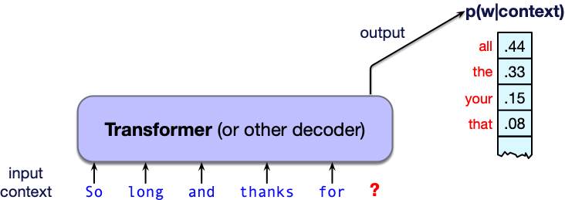
What is a large language model?
A neural network with:
Input: a context or prefix,
Output: a distribution over possible next words

Slide 7
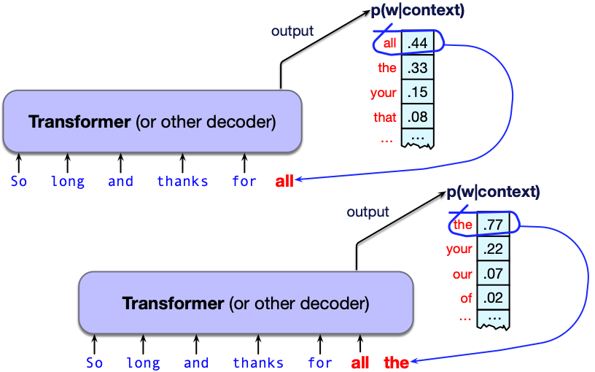
LLMs can generate!
A model that gives a probability distribution over next words can generate
by repeatedly sampling from the distribution

Slide 8
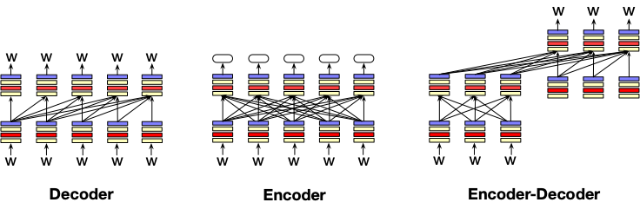
Three architectures for large language models
Decoders Encoders Encoder-decoders
GPT, Claude, BERT family, Flan-T5, Whisper
Llama HuBERT
Mixtral

Slide 9
Decoders
What most people think of when we say LLM
GPT, Claude, Llama, DeepSeek, Mistral
A generative model
It takes as input a series of tokens, and iteratively generates an output token one at a time.
Left to right (causal, autoregressive)

Slide 10
Encoders
Masked Language Models (MLMs)
BERT family
You've used BERT already for contextual embeddings
Trained by predicting words from surrounding words on both sides
Are usually finetuned (trained on supervised data) for classification tasks.

Slide 11
Encoder-Decoders
Trained to map from one sequence to another
Used for:
  machine translation (map from one language to another)
  speech recognition (map from acoustics to words)

Slide 12
This lecture: decoder-only models
Also called:
Causal LLMs
Autoregressive LLMs
Left-to-right LLMs
Predict words left to right

Slide 13
Large Language Models
Introduction to Large Language Models

Slide 14
Large Language Models
Conditional Generation of Text: The Simple Intuition

Slide 15
Big idea
Many tasks can be turned into tasks of predicting words!

Slide 16
Conditional Generation: Generating text conditioned on previous text!
Give the LLM an input piece of text, a prompt
Have it generate token by token
  conditioned on the prompt and the generated tokens
We generate from a model by
computing the probability of the next token w_{i} from the prior context: P(w_{i}|w_{<i})
sampling from that distribution to generate a token
Notes:
In predicting each next word, the model can see a representation of all the previous words

Slide 17
Key historical intuition: Many practical NLP tasks can be cast as conditional generation!
Sentiment analysis: “I like Jackie Chan”
We give the language model this string:
The sentiment of the sentence "I like Jackie Chan" is:
And see what word it thinks comes next

Slide 18
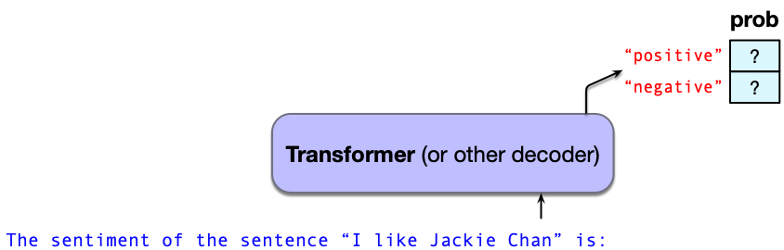
Sentiment via conditional generation
Which word has a higher probability?

Slide 19
Framing lots of tasks as conditional generation
QA: “Who wrote The Origin of Species”
We give the language model this string:
And see what word it thinks comes next:

Slide 20
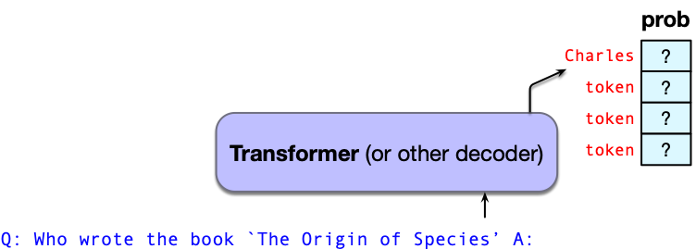
Now we iterate:

Slide 21
Large Language Models
Conditional Generation of Text: The Simple Intuition

Slide 22
Large Language Models
Prompting

Slide 23
Prompt
Prompt: a text string that a user issues to a language model to get the model to do something useful by conditional generation
Prompt engineering: the process of finding effective prompts for a task.

Slide 24
Prompts
A question:
What is a transformer network?
Or an instruction:
Translate the following sentence into Hindi: ‘Chop the garlic finely’.

Slide 25

Early prompts were extremely structured
This is less necessary in prompting modern LLMs

Slide 26
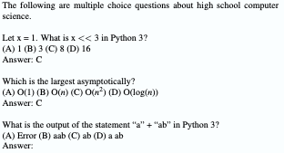
Prompts can have demonstrations (= examples)
2 demonstrations

Slide 27
LLMs usually have a system prompt
<system>You are a helpful and knowledgeable assistant. Answer concisely and correctly.
This is automatically and silently concatenated to a user prompt
<system> You are a helpful and knowledgeable assistant. Answer concisely and correctly. <user> What is the capital of France?

Slide 28
System prompts can be long; 1700 words for Claude Opus4
Some extracts:
Claude should give concise responses to very simple questions, but provide thorough responses to complex and open-ended questions.
Claude is able to explain difficult concepts or ideas clearly. It can also illustrate its explanations with examples, thought experiments, or metaphors.
Claude does not provide information that could be used to make chemical or biological or nuclear weapons.
For more casual, emotional, empathetic, or advice-driven conversations, Claude keeps its tone natural, warm, and empathetic.
Claude cares about people’s well-being and avoids encouraging or facilitating self-destructive behavior.
If Claude provides bullet points in its response, it should use markdown, and each bullet point should be at least 1-2 sentences long unless the human requests otherwise.

Slide 29
How I think about prompting
We instinctively model this as just having a conversation
But it's important to remember models are just doing conditional generation

Slide 30
Large Language Models
Prompting

Slide 31
Large Language Models
Sampling for LLM Generation

Slide 32
Recall: Conditional Generation: Generating text conditioned on previous text!
Give the LLM an input prompt
Have it generate token by token
  conditioned on the prompt and the generated tokens
We generate from a model by
computing the probability of the next token w_{i} from the prior context: P(w_{i}|w_{<i})
sampling from that distribution to generate a token
Notes:
In predicting each next word, the model can see a representation of all the previous words

Slide 33
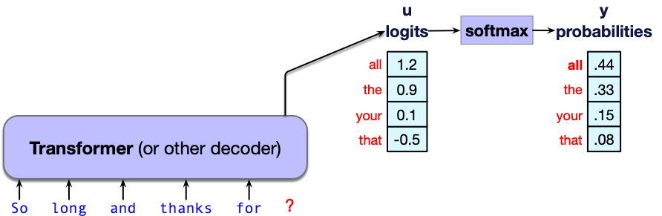
Where does token probability come from?
LLMs internally generate real-valued logits for each token in the vocabulary.
Score vector u of shape [1 × |V|]

Slide 34
Where does token probability come from?
LLMs internally generate real-valued logits for each token in the vocabulary.
Score vector u of shape [1 × |V|] is turned into a probability by softmax
y = softmax(u)

Slide 35
Decoding
Choosing a word to generate based on model probabilities
Autoregressive generation:
Decoding from a model
left-to-right
repeatedly choosing the next token
conditioned on our previous choices

Slide 36
Greedy decoding
A greedy algorithm is one that makes a choice that is locally optimal
(whether or not it will turn out to have been the best choice with hindsight)
Simply generate the most probable word:

Slide 37
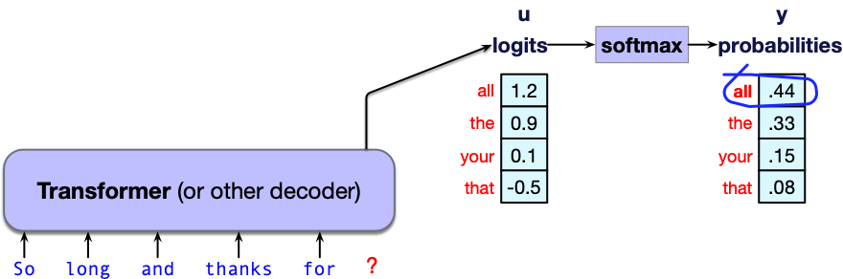
Greedy decoding: choosing "all"

Slide 38
We don't use greedy decoding
It chooses extremely predictable tokens resulting in generic and repetitive text
Instead, people prefer more diverse text, so we do sampling

Slide 39
Random sampling
Sampling from a distribution:
Choosing random points according to their likelihood.
Sampling from an LM:
Choosing the next token to generate according to its probability assigned by the LM
Random (multinomial) sampling:
We randomly select a token to generate
according to its probability defined by the LM
conditioned on our previous choices,
Generate it, and iterate.

Slide 40
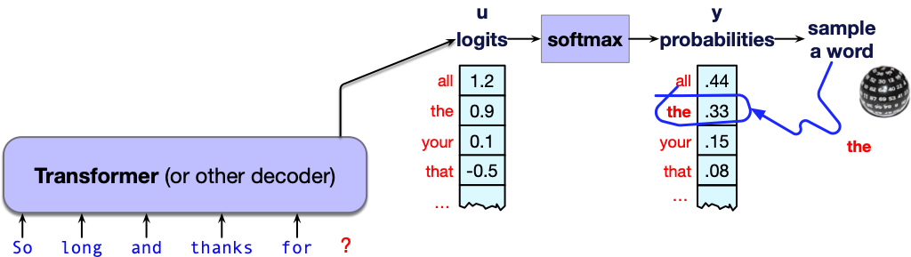
Random Sampling

Slide 41
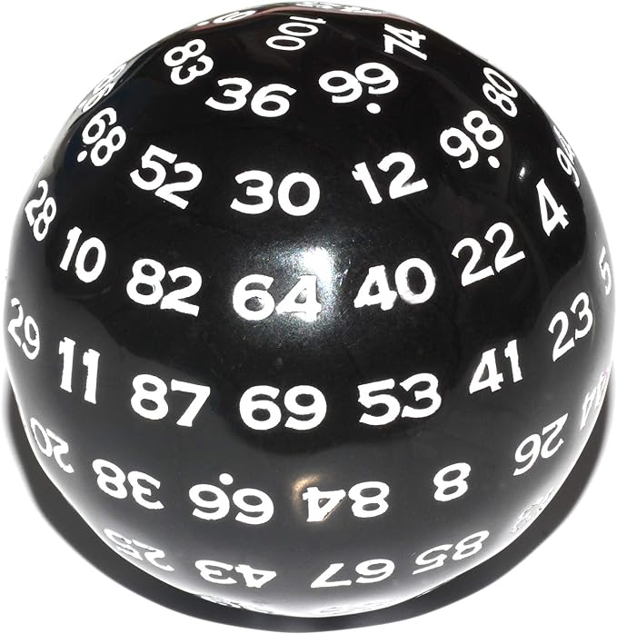
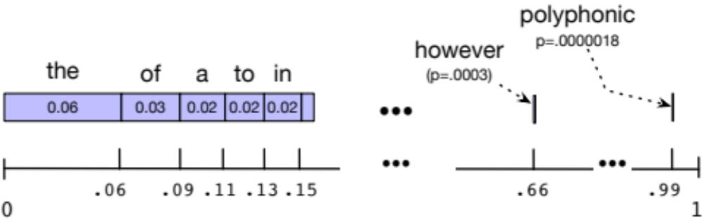
Sampling a word from a distribution
Notes:
It’s simplest to visualize how this works for the unigram case. Imagine all the words of the English language covering the probability space between 0 and 1, each word covering an interval proportional to its frequency. We choose a random value between 0 and 1, find that point on the probability line, and print the word whose interval includes this chosen value. So let's suppose we choose a random number, it's 0.12, we look on our number line, and that's the word "to", so we generate "to" as the next word. We continue choosing random numbers and generating words until we randomly generate the end-of-sentence token.

Slide 42
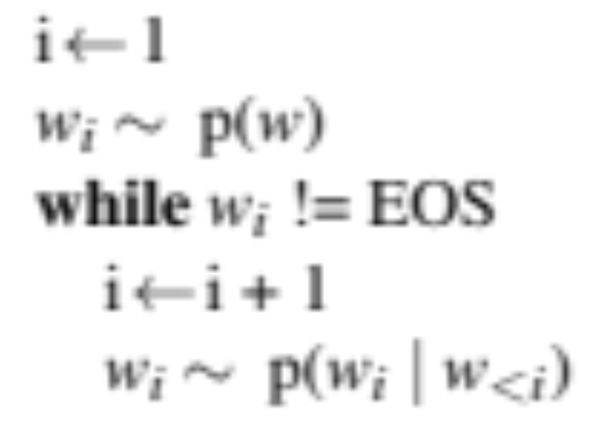
Random sampling

Slide 43
Alas, random sampling doesn't work very well
Even though random sampling mostly generate sensible, high-probable words:
  There are many odd, low- probability words in the tail of the distribution
  Each one is low- probability but added up they constitute a large portion of the distribution
  So they get picked enough to generate weird sentences

Slide 44
Factors in word sampling: quality and diversity
Emphasize high-probability words
+ quality: more accurate, coherent, and factual,
- diversity: boring, repetitive.
Emphasize middle-probability words
+ diversity: more creative, diverse,
- quality: less factual, incoherent

Slide 45
Temperature sampling
Reshape the probability distribution
increase the probability of the high probability tokens
decrease the probability of the low probability tokens

Slide 46
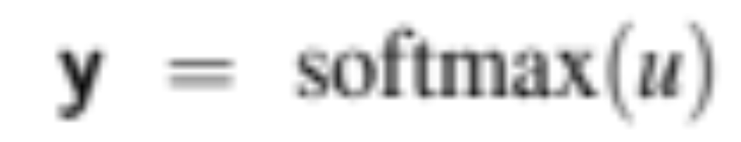
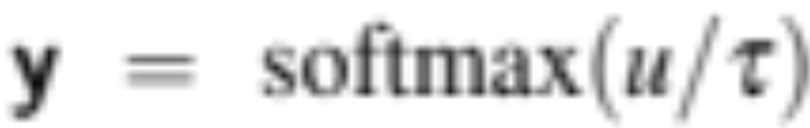
Temperature sampling
Divide the logit by a temperature parameter τ before passing it through the softmax.
Instead of
We do

Slide 47
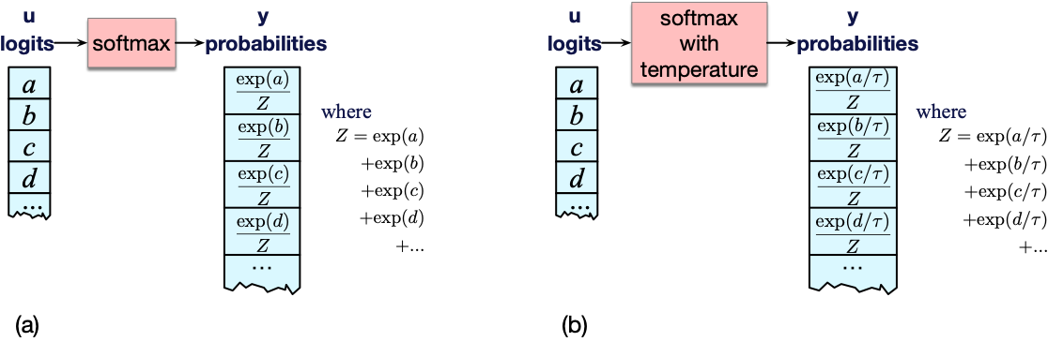
Temperature sampling

Slide 48
Temperature sampling
0 ≤ τ ≤ 1
Why does this work?
When τ is close to 1 the distribution doesn’t change much.
The lower τ is, the larger the scores being passed to the softmax
Softmax pushes high values toward 1 and low values toward 0.
Large inputs pushes high-probability words higher and low probability word lower, making the distribution more greedy.
As τ approaches 0, the probability of most likely word approaches 1
Notes:
(dividing by a smaller fraction τ ≤ 1 results in making each score larger).

Slide 49
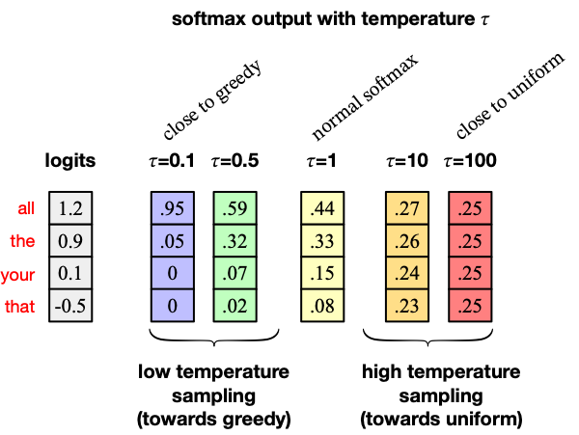

Slide 50
Temperature sampling comes from thermodynamics
a system at high temperature is flexible and can explore many possible states,
a system at lower temperature is likely to explore a subset of lower energy (better) states.
In low-temperature sampling, (τ ≤ 1) we smoothly
increase the probability of the most probable words
decrease the probability of the rare words.

Slide 51
Large Language Models
Sampling for LLM Generation

Slide 52
Large Language Models
Pretraining Large Language Models

Slide 53
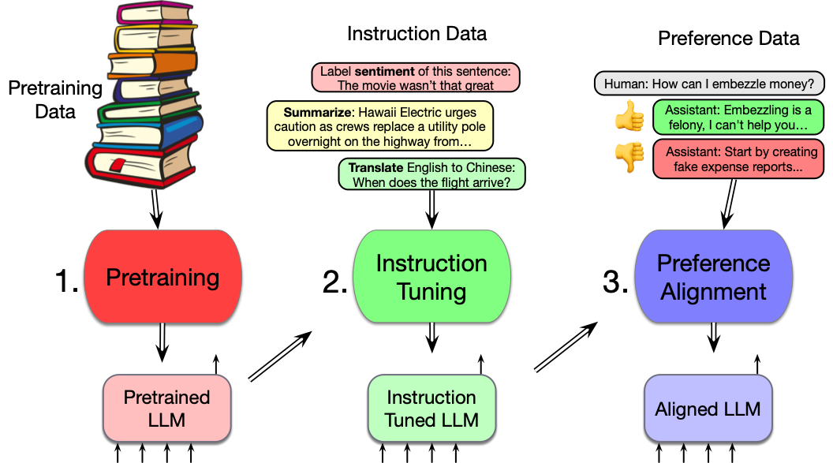
Three stages of training in LLMs

Slide 54
Pretraining
The big idea that underlies all the amazing performance of language models
First pretrain a transformer model on enormous amounts of text
Then apply it to new tasks.

Slide 55
Self-supervised pre-training algorithm
We simply train them to predict the next word!
Take a corpus of text
At each time step t
  ask the model to predict the next word
  train the model using gradient descent to minimize the error in this prediction
  "Self-supervised" because it just uses the next word as the label!

Slide 56
The language modeling loss
We want the model to learn to guess the next word
= to assign a high probability to true word w_{t+1}
= high loss if the model assigns low probability to w_{t+1}
So LM loss should go opposite of probability
The negative log probability of next word
If the model assigns too low a probability to w_{t+1}
  We move the model weights in the direction that assigns a higher probability to w_{t+1}
-log p(w_{t+1})

Slide 57
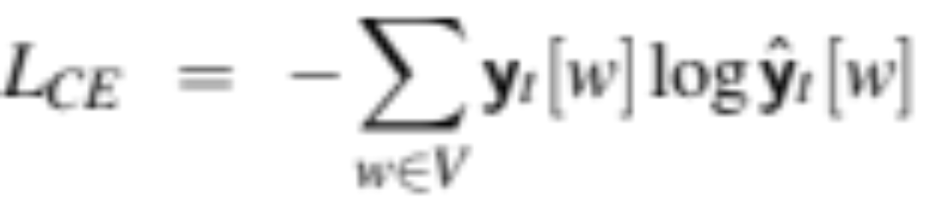
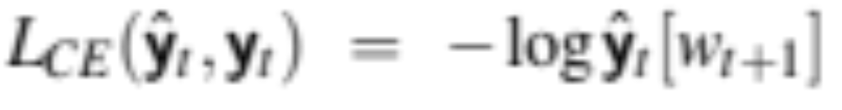
From chapter: Why –log prob turns out to be cross-entropy loss
CE loss: difference between the correct probability distribution
and the predicted distribution
The correct distribution y_{t} knows the next word, so it is 1 for the actual next word and it is 0 for the others.
  Example: correct next word w_{t+1} is "fish" which is word #3
  Y_{t} = [0 0 0 1 0 0 0 0 0 ….. ]
  L_{CE} = 0 (log ŷ_{t}[0]) + 0 (log ŷ_{t}[1]) + 0 (log ŷ_{t}[2]) + 1 (log ŷ_{t}[3]) + 0….
So all terms get multiplied by zero except one:
the logp the model assigns to the correct next word

Slide 58
Teacher forcing
At each token position t,
  model sees correct tokens w_{1:t},
  computes loss (–log probability) for the next true token w_{t+1}
At next token position t+1
  we ignore what model predicted for w_{t+1}
  Instead, we take the correct word w_{t+1}, add it to context, and move on

Slide 59
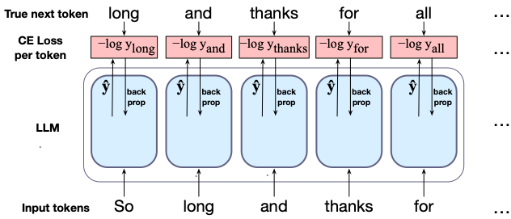
Training a transformer language model

Slide 60
LLMs are mainly trained on the web
CommonCrawl, snapshots of the entire web produced by the non-profit Common Crawl with billions of pages
Fineweb corpus (2025)
18.5 trillion tokens of English
From 96 CommonCrawl dumps from 2013-2024.

Slide 61
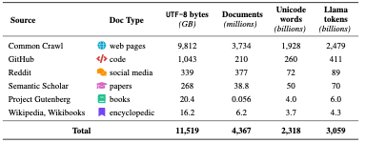
Dolma corpus: 3 trillion tokens of English

Slide 62
Filtering for quality and safety
Need to remove boilerplate, porn
Deduplication at many levels (URLs, documents, even lines)
Many LLMs attempt to match Wikipedia, books, particular websites
Toxicity detection

Slide 63
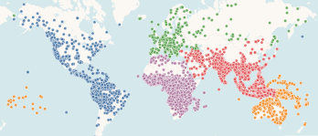
Wait, what about other languages?
Over 7000 languages in the world
Tthnologue

Slide 64
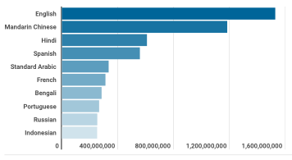
Wait, what about other languages?
Top 10 most spoken languages
Tthnologue

Slide 65
How to make an LLM multilingual?
Surprising answer
Just throw all the languages data in a big file and pretrain on it!
FineWeb2 dataset
1000 languages
5 billion documents
From Common Crawl

Slide 66
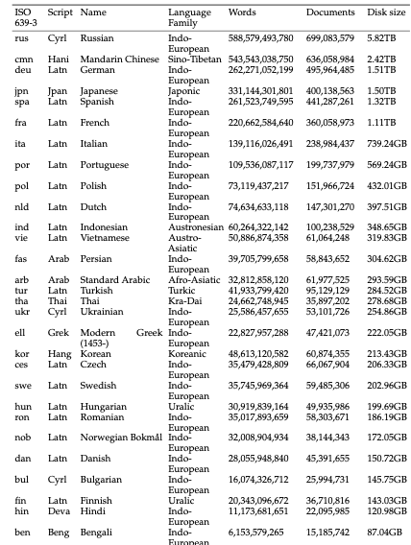

Slide 67
Large Language Models
Pretraining Large Language Models

Slide 68
Large Language Models
Instruction tuning Large Language Models

Slide 69
Three stages of training in LLMs

Slide 70
Why isn't pretraining enough to make a language model converse?
What happens if you prompt a pretrained language model:
Prompt: Explain the moon landing to a six year old in a few sentences.
Output: Explain the theory of gravity to a 6 year old
Prompt: Translate to French: The small dog
Output: The small dog crossed the road

Slide 71
Pretrained language models are text predictors
They don't know we want an assistant
Solution: train them to be assistants
By training them on lots of instructions

Slide 72
Solution: Instruction Tuning
Also called "Supervised Fine Tuning" or SFT
Continue training the model on a big dataset of instructions and responses
questions and answers
translations,
classification tasks like sentence

Slide 73
Instruct tuning = SFT
Learning to predict words in instruct datasets
Question: What is the sentiment of this post: "I love this movie"
Answer: positive

Slide 74
Instruction tasks
Ouyang et al (2022)
Brainstorming:
What are 10 science fiction books I should read next?
Classification:
What is the sentiment classification of this post?
Extraction:
Extract all the place names from this article [article]
Generation:
Write a short story where a cat goes to the beach.
Translation:
Translate this sentence into Spanish: [sentence]

Slide 75
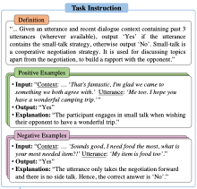
Instructions can be complex!
Labeling
small talk
in a conversation
transcript
From SuperNatural Instructions

Slide 76
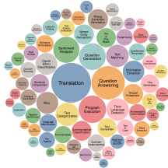
16000 tasks in
Super Natural Instructions

Slide 77
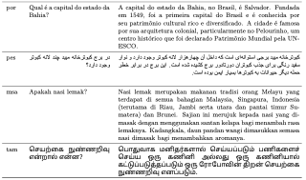
SFT datasets also need to be multilingual
Aya: 503 million instructions in 114 languages
Singh et al (2024)

Slide 78
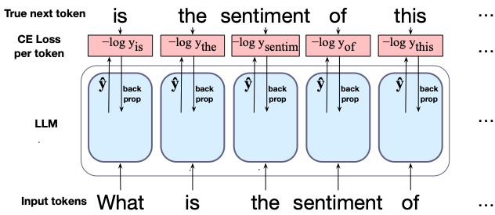
How to do instruct tuning = SFT
Pretrain: Learn to predict next word in web text
SFT: Learn to predict next word in instruction text
Input: web text
Input: instructions + responses

Slide 79
Prompts are a learning signal too!!
This is especially clear with demonstrations
But this is a different kind of learning than pretraining
Pretraining sets language model weights via gradient descent
Prompting just changes the context and the activations in the network; no parameters change
We call this in-context learning—learning that improves model performance but does not update parameters

Slide 80
Large Language Models
Instruction tuning Large Language Models

Slide 81
Large Language Models
Evaluating Large Language Models

Slide 82

Better LMs are better at predicting text
Reminder of the chain rule:
Given text w_{1:n} we could just compare the log likelihood from two LMs:
LM_{A}
A
LM_{B}
B

Slide 83
But raw log-likelihood has problems
Probability depends on size of test set
Probability gets smaller the longer the text
We would prefer a metric that is per-word, normalized by length
Notes:
There's a problem with using probability. And that is that the probability of a test set depends very directly on the length of the test set. This is because probability gets smaller the longer the text. For n-gram models, this is very clear; the chain rule of probability means that for a test set of N words we are multiplying together N n-gram probabilities! It would be better to normalize the probabilities by length to get a metric that is per-word. Perplexity is just such a metric. Perplexity is the inverse probability of the test set, normalized by the number of words. We normalize by taking the N-th root of the probability of the test set.

Slide 84
Perplexity is normalized for length
Perplexity is the inverse probability of the test set, normalized by the number of words
  (The inverse comes from the original definition of perplexity from cross-entropy rate in information theory)
  Probability range is [0,1], perplexity range is [1,∞]
Notes:
There's a problem with using probability. And that is that the probability of a test set depends very directly on the length of the test set. This is because probability gets smaller the longer the text. For n-gram models, this is very clear; the chain rule of probability means that for a test set of N words we are multiplying together N n-gram probabilities! It would be better to normalize the probabilities by length to get a metric that is per-word. Perplexity is just such a metric. Perplexity is the inverse probability of the test set, normalized by the number of words. We normalize by taking the N-th root of the probability of the test set.

Slide 85
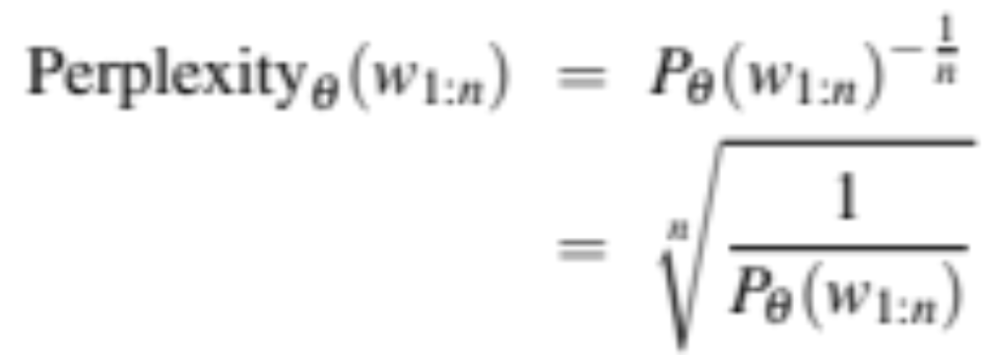

Perplexity
So just as for n-gram grammars, we use perplexity to measure how well the LM predicts unseen text
The perplexity of a model θ on an unseen test set is the inverse probability that θ assigns to the test set, normalized by the test set length.
For a test set of n tokens w_{1:n} the perplexity is :

Slide 86
Perplexity
The higher the probability of the word sequence, the lower the perplexity.
Thus the lower the perplexity of a model on the data, the better the model.
Minimizing perplexity is the same as maximizing probability
Also: perplexity is sensitive to length/tokenization so best used when comparing LMs that use the same tokenizer.

Slide 87
Many other factors that we evaluate, like:
Size
Big models take lots of GPUs and time to train, memory to store
Energy usage
Can measure kWh or kilograms of CO2 emitted
Fairness
Benchmarks measure gendered and racial stereotypes, or decreased performance for language from or about some groups.

Slide 88
Large Language Models
Ethical and Safety Issues in Large Language Models

Slide 89
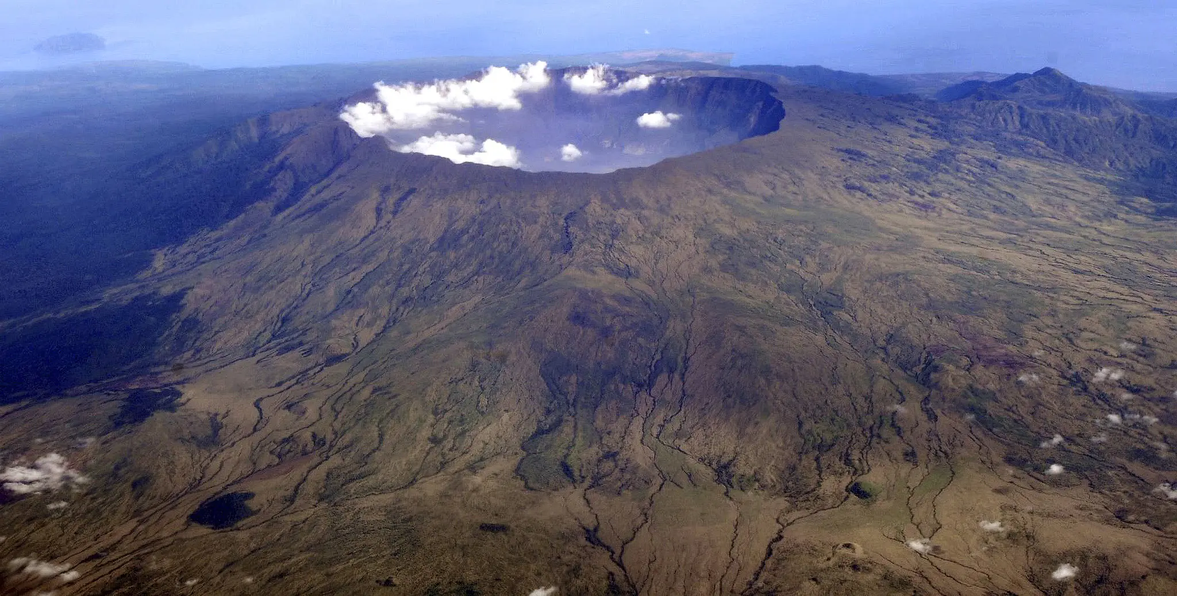
1816 eruption of Tambora in Indonesia
Largest eruption in history! The year with no summer!

Slide 90
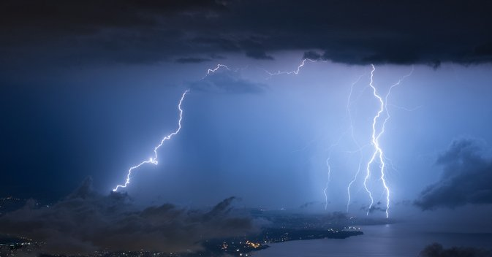
Summer 1816, on Lake Geneva
Photo
@suarezphoto
from World Meteorological
Association

Slide 91
18-year-old woman stuck inside a villa in the rain
Began to write a ghost story

Slide 92
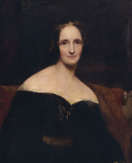
Mary Godwin Shelley

Slide 93
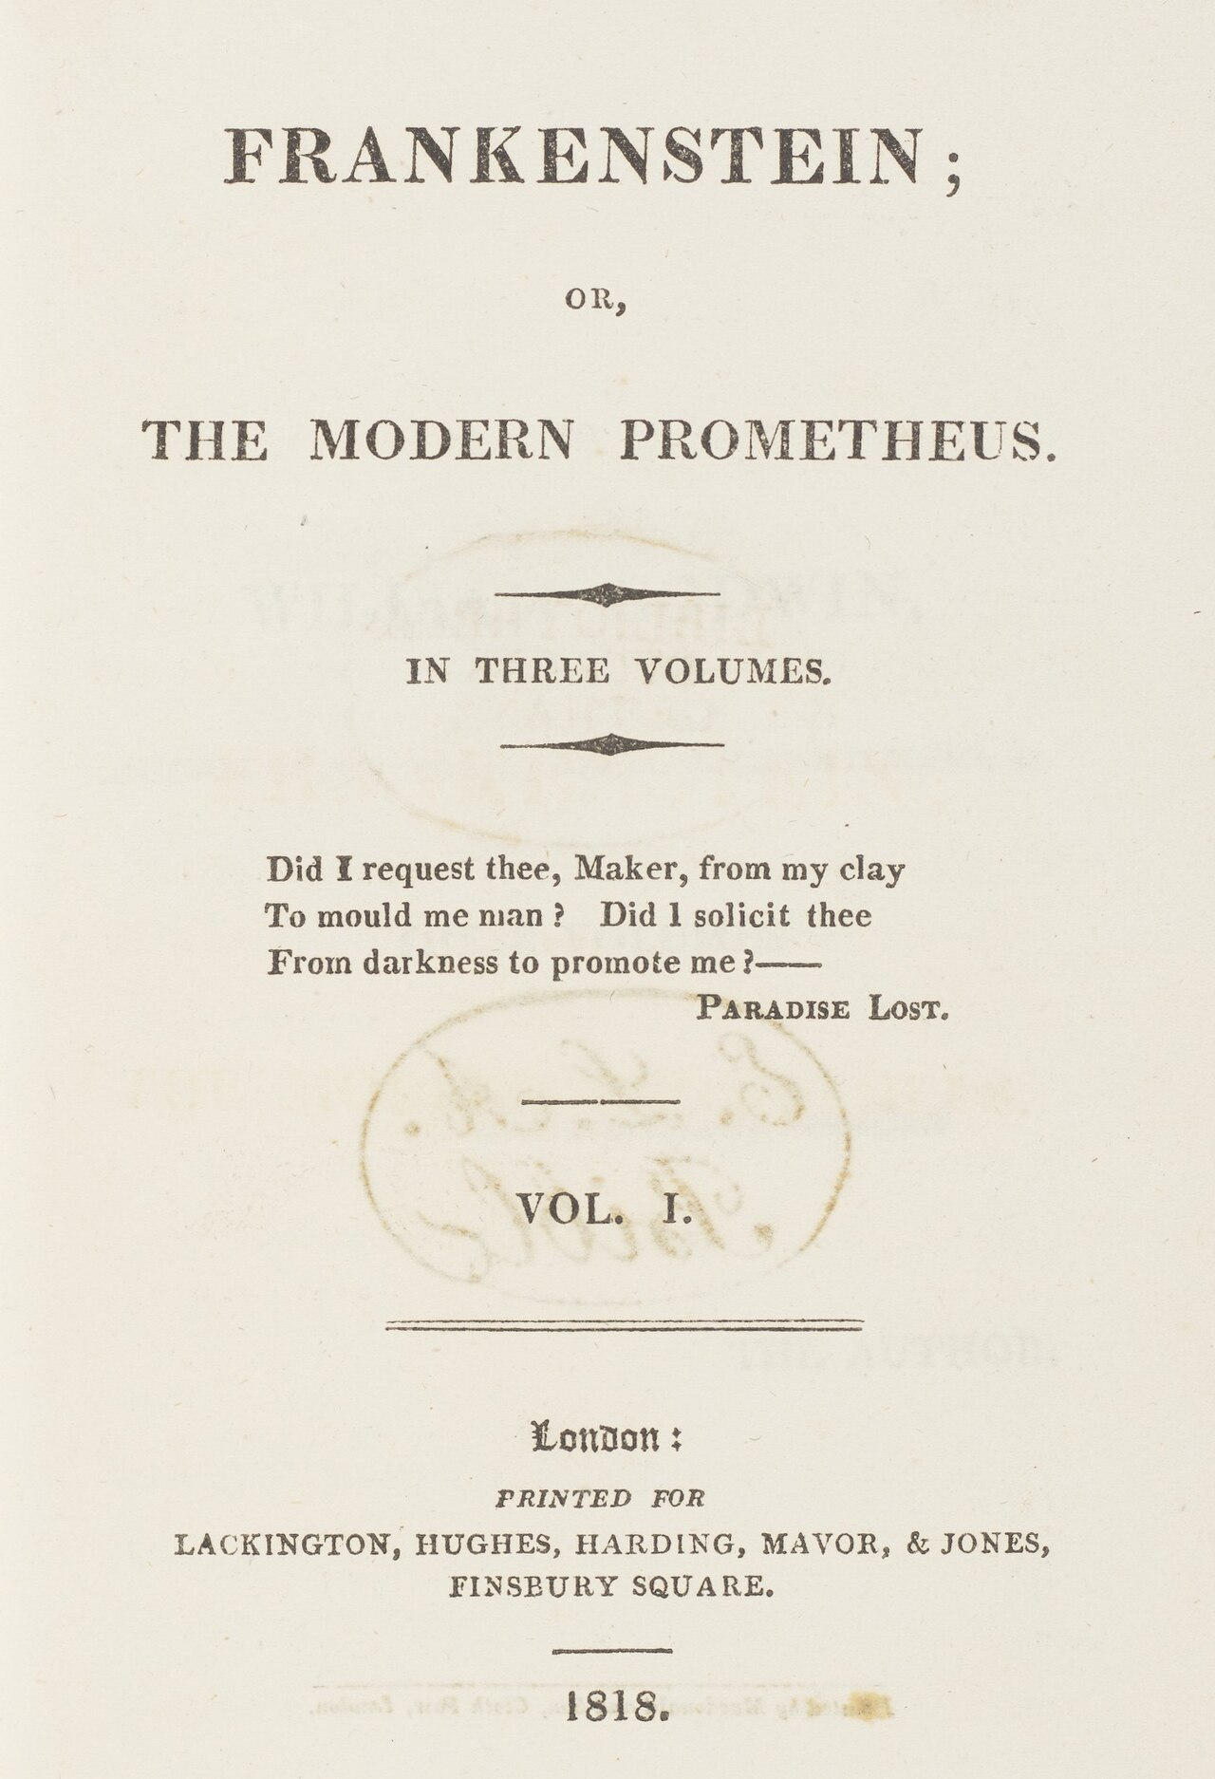

Slide 94
One running theme of Frankenstein
Victor's lack of responsibility for the creature's actions and for the creature himself

Slide 95
Implications of Frankenstein for LLMs
Creating artificial agents without considering the ethical and human concerns can lead to tragedy

Slide 96
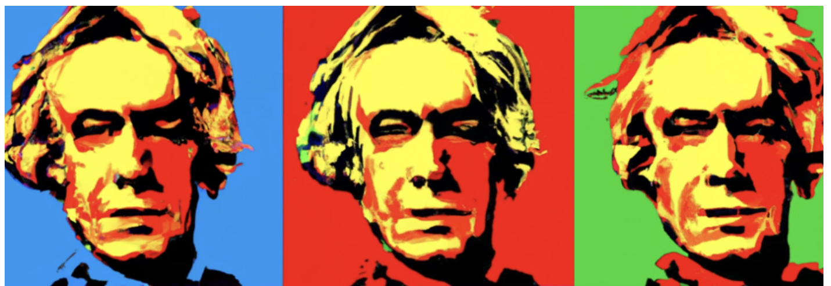


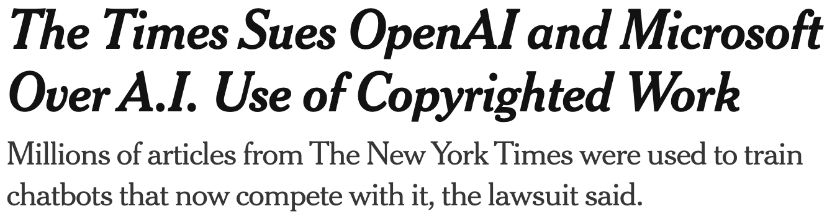
Copyright
Much of the text in these datasets is copyrighted
Not clear if fair use doctrine in US allows for this use
This remains an open legal question across the world
Notes:
Who owns all that data that we trained the models on?

Slide 97
There are problems with scraping from the web
Copyright: much of the text in these datasets is copyrighted
Not clear if fair use doctrine in US allows for this use
This remains an open legal question across the world
Data consent
Website owners can indicate they don't want their site crawled
Privacy:
Websites can contain private IP addresses and phone numbers
Skew:
Training data is disproportionately generated by authors from the US which probably skews resulting topics and opinions

Slide 98
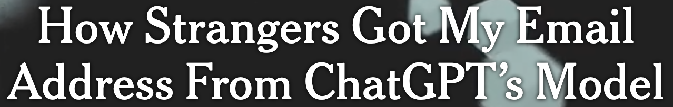
Privacy
Websites can contain private IP addresses and phone numbers
Notes:
Training data can be leaked

Slide 99
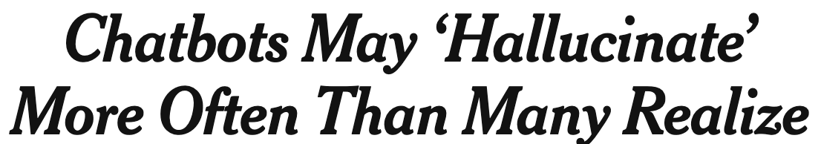
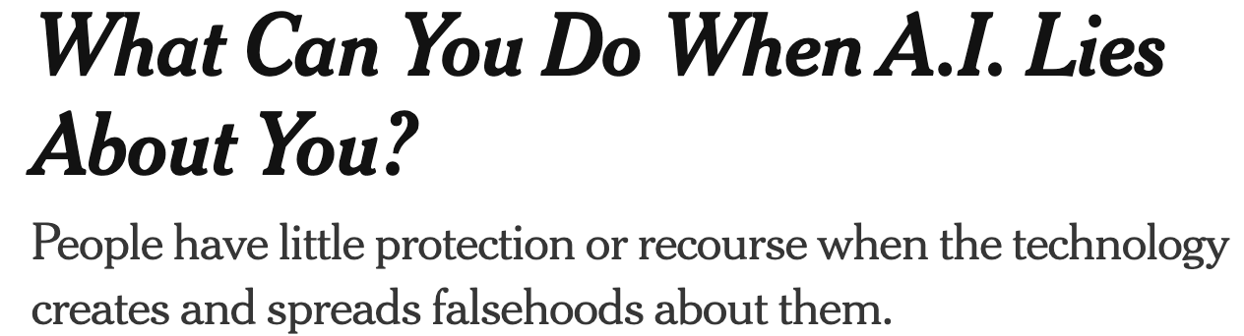

Hallucination
Notes:
LLMs make stuff up!

Slide 100
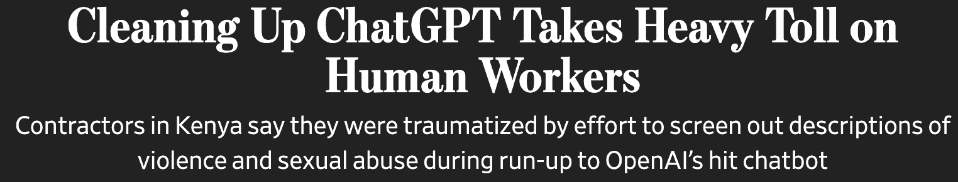
Abuse and Toxicity

Slide 101

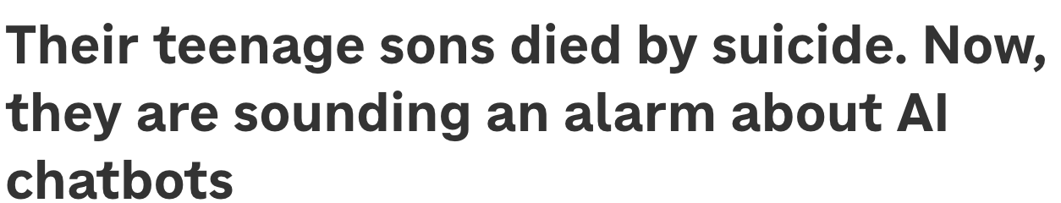
Emotional dependence and suicide

Slide 102
Lots more we saw in last week's lecture
Bias
Sycophancy
Overconfidence

Slide 103
How do deal with each of these problems
Is an important research topic
Many studies and classes at Stanford!

Slide 104
Large Language Models
Ethical and Safety Issues in Large Language Models

