Slide 1
CS276: Information Retrieval and Web Search
Lecture 19: Web Question Answering
Christopher Manning
Pandu Nayak
Notes:
Final exam procedures
Sample final exam
All grades will be available by next Thursday morning!

Slide 2
“Information retrieval”
The name information retrieval is standard, but as traditionally practiced, it’s not really right
All you get is document retrieval, and beyond that the job is up to you

Slide 3

Getting information
The common person’s view? [From a novel]
  “I like the Internet. Really, I do. Any time I need a piece of shareware or I want to find out the weather in Bogota … I’m the first guy to get the modem humming. But as a source of information, it sucks. You got a billion pieces of data, struggling to be heard and seen and downloaded, and anything I want to know seems to get trampled underfoot in the crowd.”
    Michael Marshall. The Straw Men. HarperCollins, 2002.
Notes:
Of course it is a difficult area to evaluate the performance of systems as different people have different ideas as to what constitutes an answer, especially if the systems are trying to return exact answers.

Slide 4
Web Search in 2025?
The web, it is a changing.
What will people do in 2025?
Type key words into a search box?
Use the Semantic Web?
Ask questions to their computer in natural language?
Use social or “human powered” search?

Slide 5
What do we know that’s happening?
Much of what is going on is in the products of companies, and there isn’t exactly careful research explaining or evaluating it
So most of this is my own meandering observations giving voice over to slides from others
Notes:
Danny Sullivan on SearchEngineLand

Slide 6
Google
What’s been happening? 2013–2017
Many updates a year … and 3rd party sites try to track them
  e.g., https://moz.com/google-algorithm-change by & aimed at SEOs
I just mention a few changes here
New search index at Google: “Hummingbird” (2013)
  http://www.forbes.com/sites/roberthof/2013/09/26/google-just-revamped-search-to-handle-your-long-questions/
  Answering long, “natural language” questions better
  Partly to deal with spoken queries on mobile
More use of the Google Knowledge Graph (2014)
  Concepts versus words
RankBrain (second half of 2015):
  A neural net helps in document matching for the long tail

Slide 7
Google
What’s been happening? 2013–2017
“Pigeon” update (July 2014):
  More use of distance and location in ranking signals
“Mobilegeddon” (Apr 21, 2015):
  “Mobile friendliness” as a major ranking signal
“App Indexing” (Android, iOS support May 2015)
  Search results can take you to an app
Mobile-friendly 2 (May 12, 2016):
  About half of all searches are now from mobile
“Fred” (1st quarter 2017)
  Various changes discounting spammy, clickbaity, fake? sites

Slide 8
The role of knowledge bases
Google Knowledge Graph
Facebook Graph Search
Bing’s Satori
Things like Wolfram Alpha
Common theme: Doing graph search over structured knowledge rather than traditional text search

Slide 9
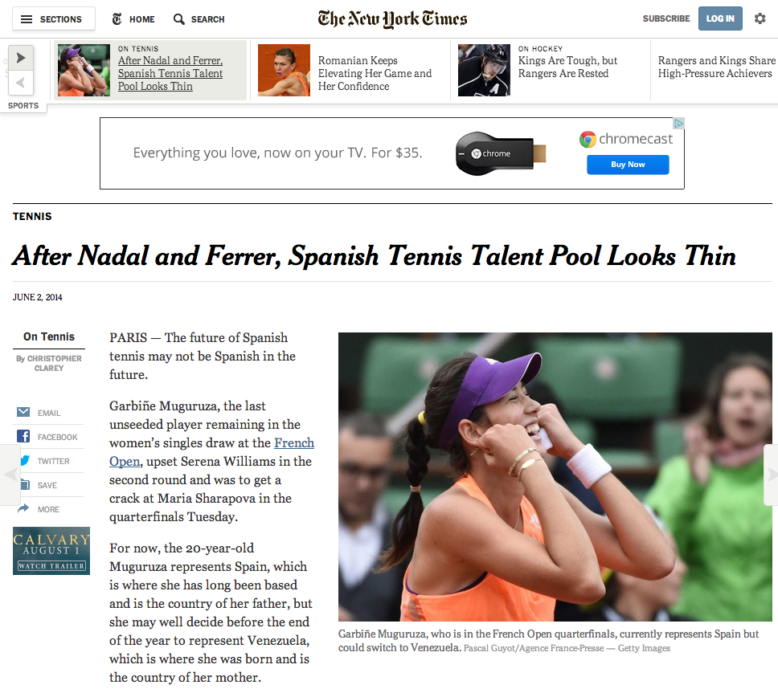
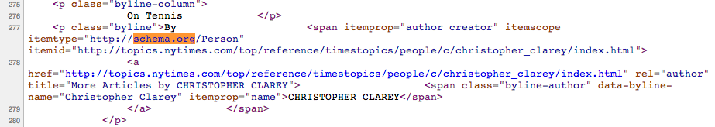
What’s been happening
More semi-structured information embedded in web pages
  schema.org

Slide 10
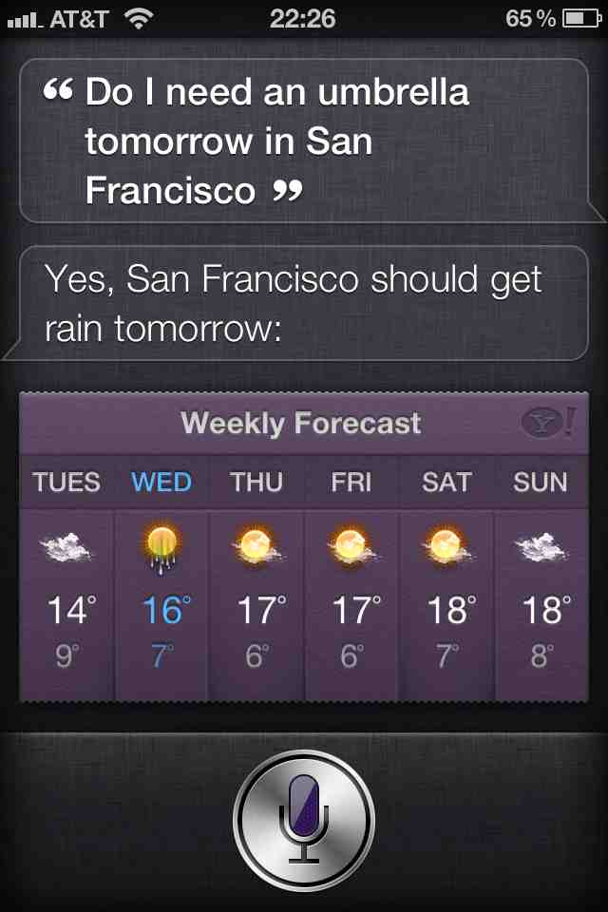
Mobile
Move to mobile favors a move to speech which favors natural language information search
  Will we move to a time when over half of searches are spoken?

Slide 11
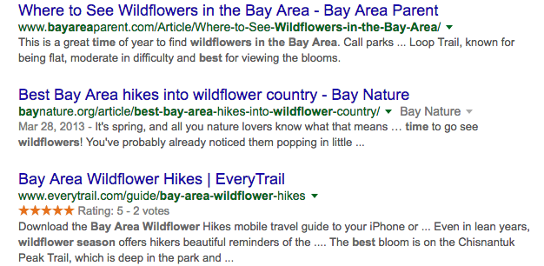
Mobile
Mobile proved importance of NLU/QA
[What is the best time for wildflowers in the bay area]
Notes:
Took long time for search ranking team to feel that QA was important. Mobile changed this.

Slide 12
Information quality
There have always been concerns about information provenance (the source) and information reliability, especially among “information professionals” (reporters, lawyers, spies, …)
It wasn’t ignored on the web: ideas like PageRank were meant to find good content, and there has been a decade of work targeting link farms, etc.
However, a lot of recent events have shown the limited effectiveness of that work, and how “fake” information easily gets upvoted and spreads

Slide 13
Towards intelligent agents
Two goals
Things not strings
Inference not search

Slide 14
Two paradigms for question answering
Text-based approaches
  TREC QA, IBM Watson, DrQA
Structured knowledge-based approaches
  Apple Siri, Wolfram Alpha, Facebook Graph Search
(And, of course, there are hybrids, including some of the above.)
At the moment, structured knowledge is back in fashion, but it may or may not last

Slide 15
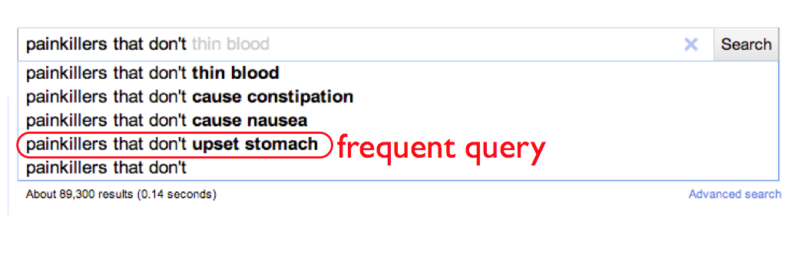
Example from Fernando Pereira (GOOG)

Slide 16
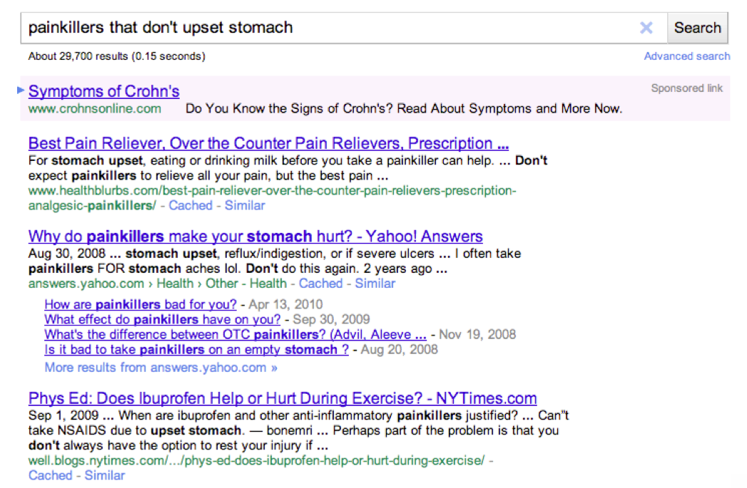

Slide 17
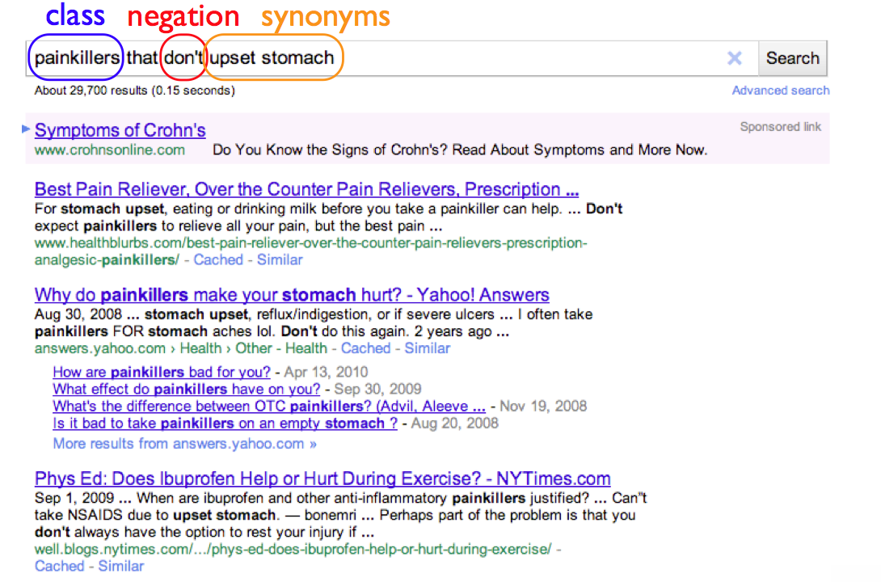

Slide 18
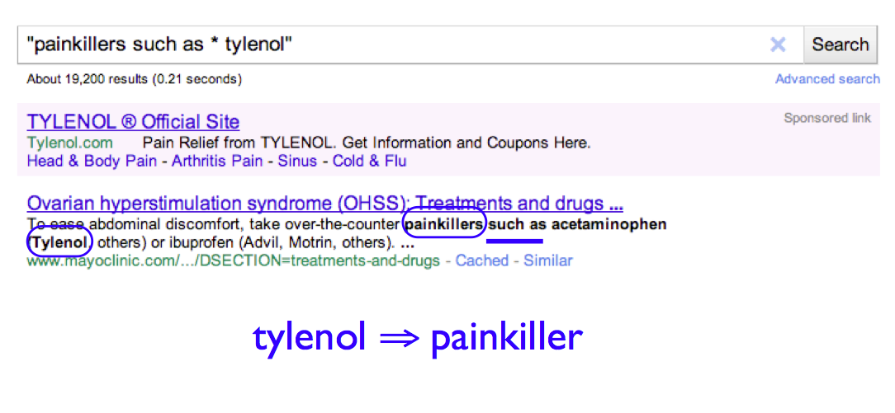

Slide 19
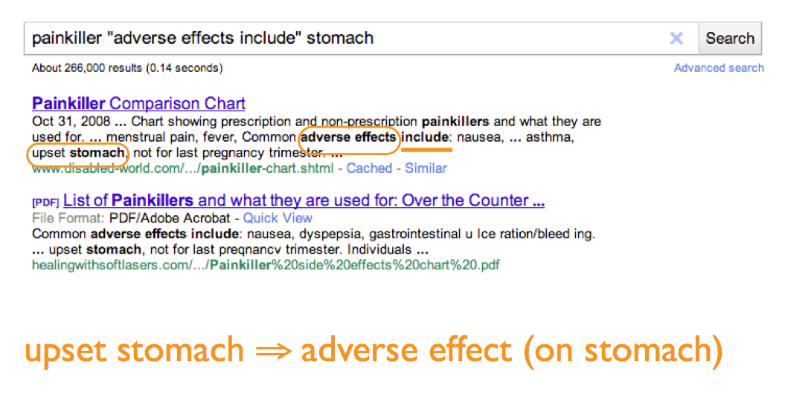

Slide 20
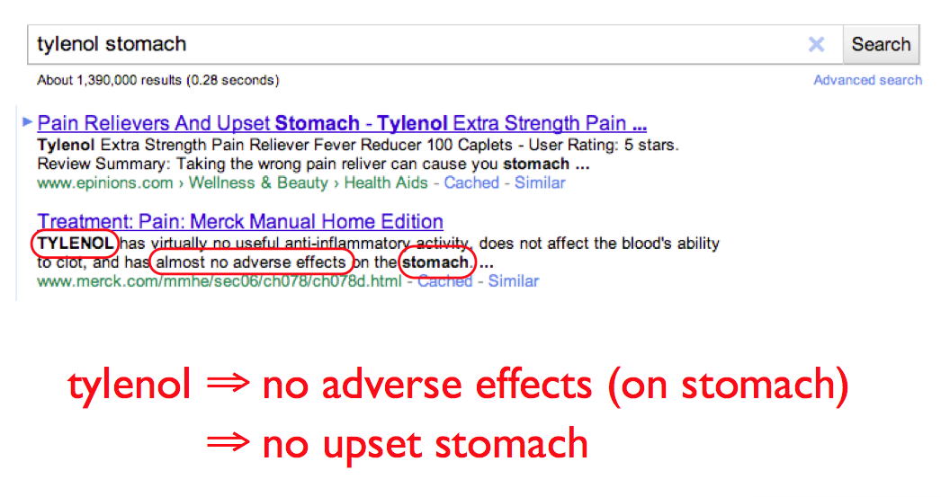

Slide 21


Slide 22
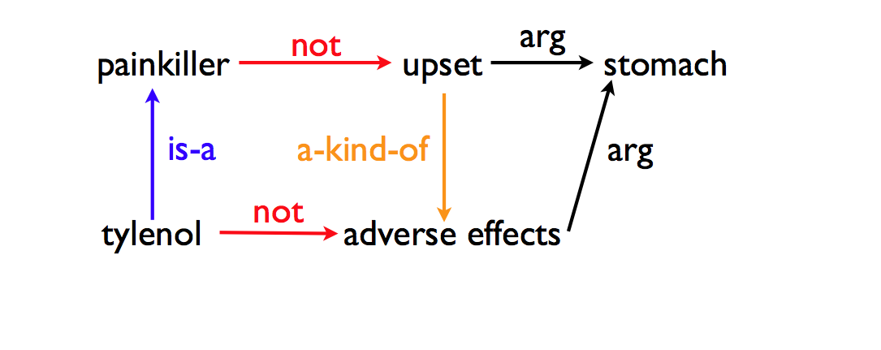

Slide 23
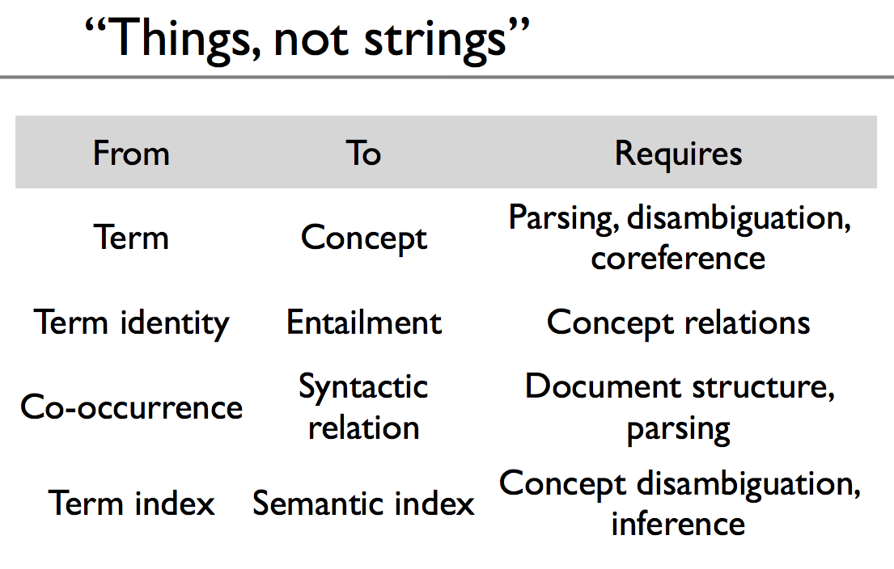

Slide 24
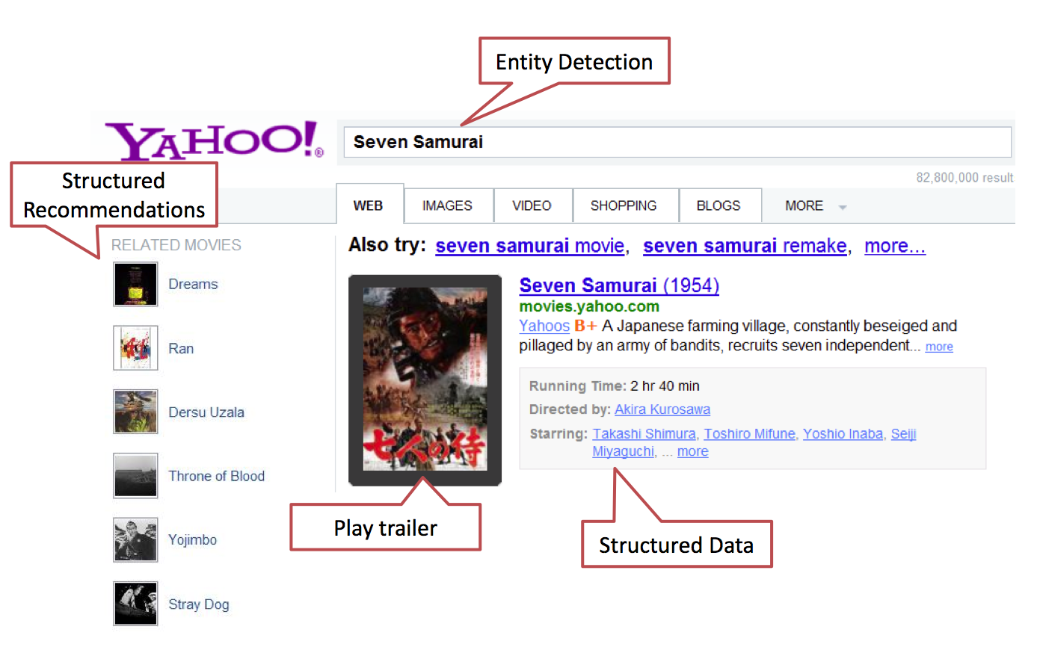
Slides from Patrick Pantel (MSFT)
Notes:
How can we exploit knowledge to better satisfy user needs for information and actions.

Slide 25
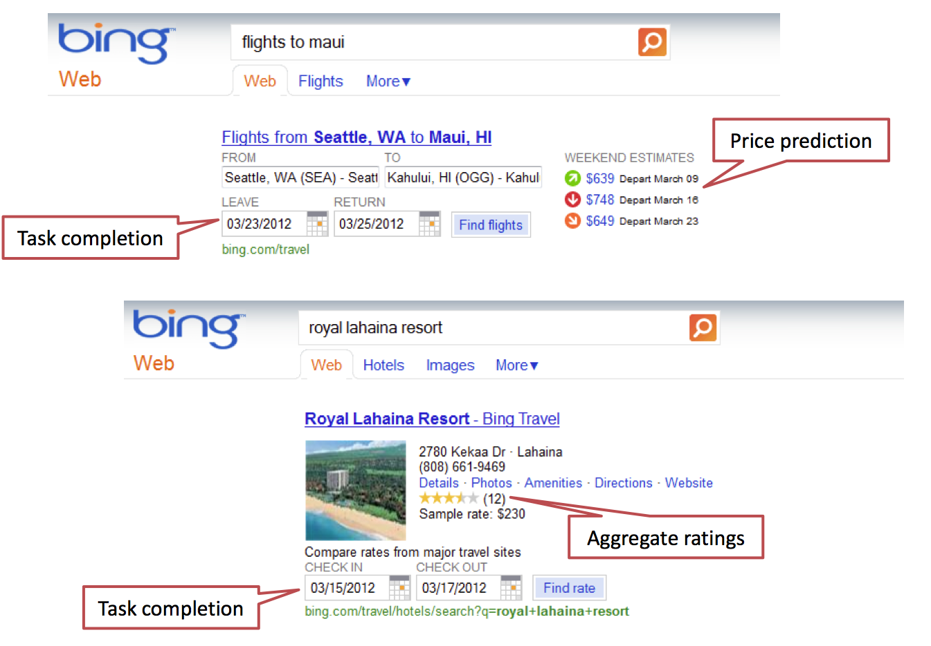

Slide 26
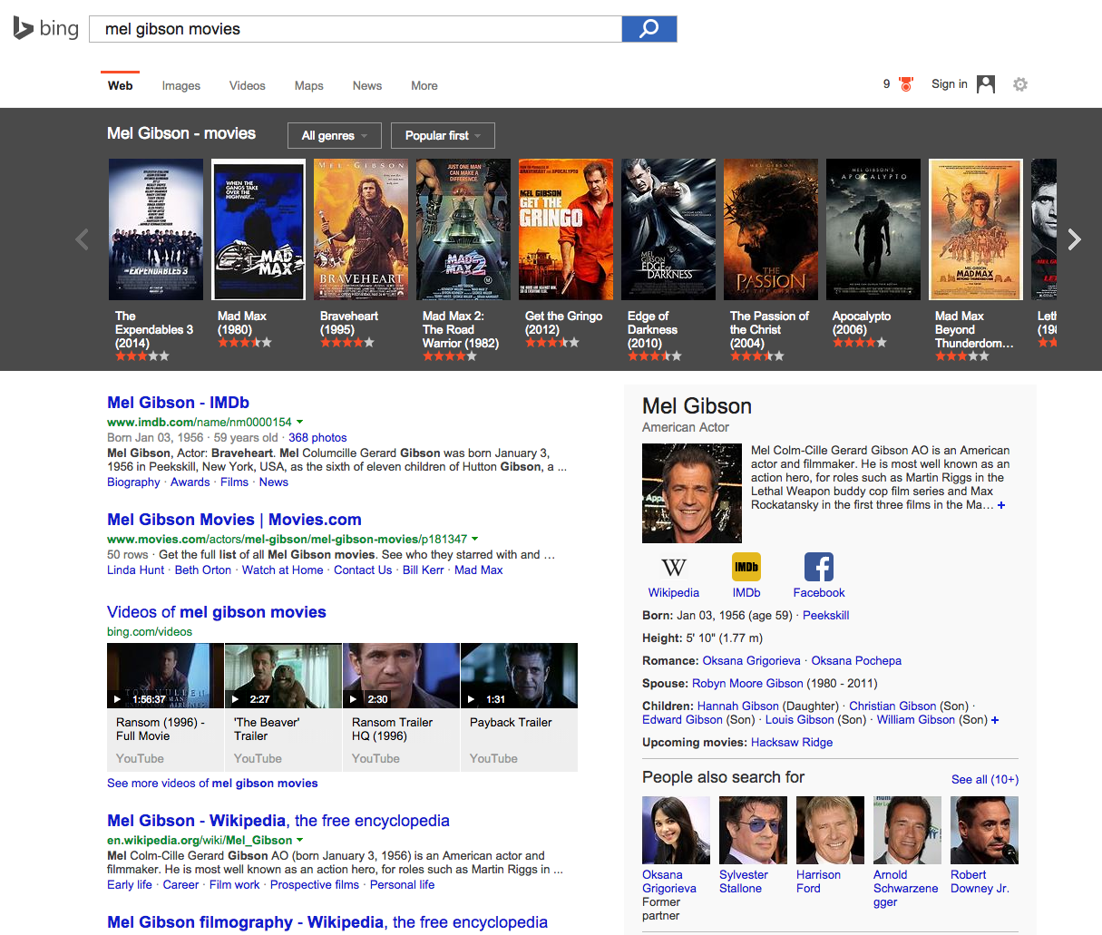
Notes:
[Six months ago,] Bing General Manager Emma Williams was sitting on the sofa with her mom, trying to find a Cary Grant movie, but neither could recall the name of the film they wanted to watch.
“I started searching on my Tivo for Cary Grant. I went through my XBox, I spent 45-minutes trying to nail down the movie – which happened to be Arsenic and Old Lace,” says Williams, “We wasted 45-minutes of our togetherness time searching.”
“We have one billion entities; we know about people, places and things, so we darn well know about Cary Grant and his movies,” said Williams. She told her staff that she wanted to invent an experience where she could find Cary Grant’s Arsenic and Old Lace in four seconds.

Slide 27
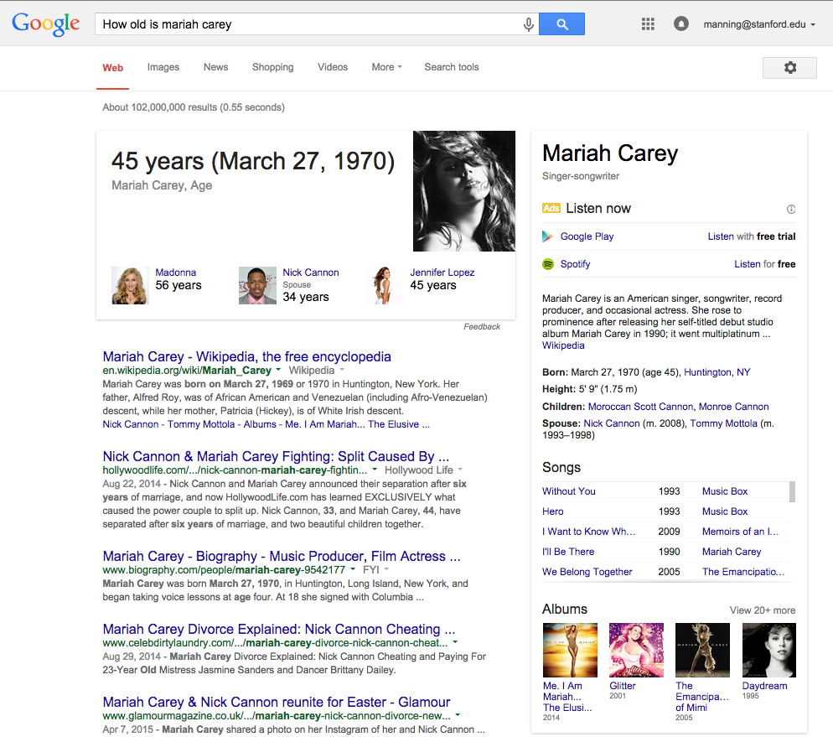
Structured Data
Direct Answer

Slide 28
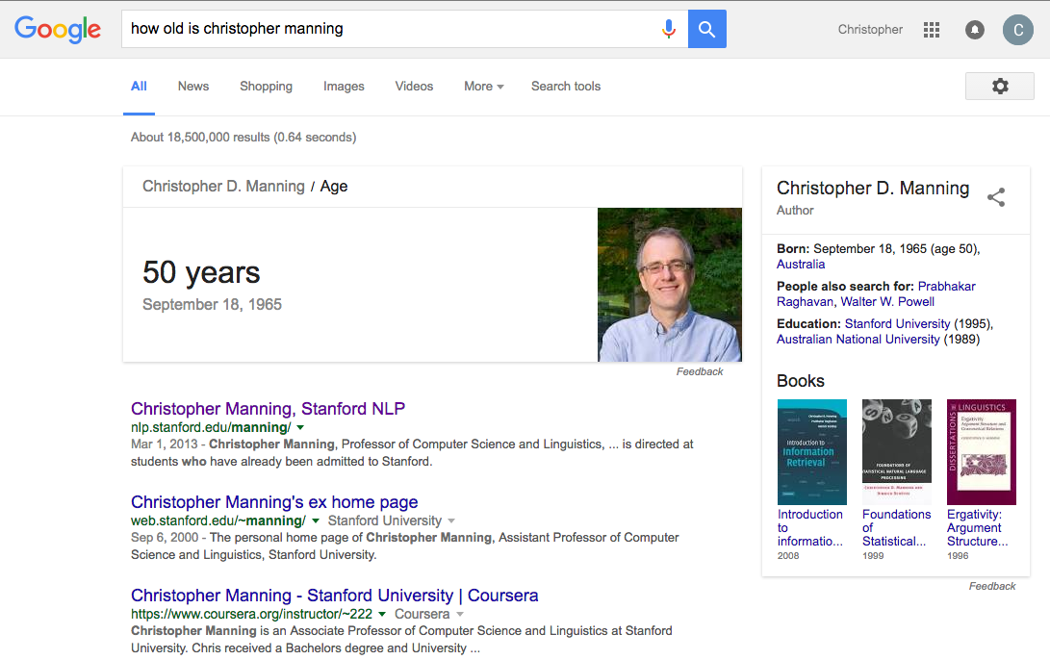

Slide 29
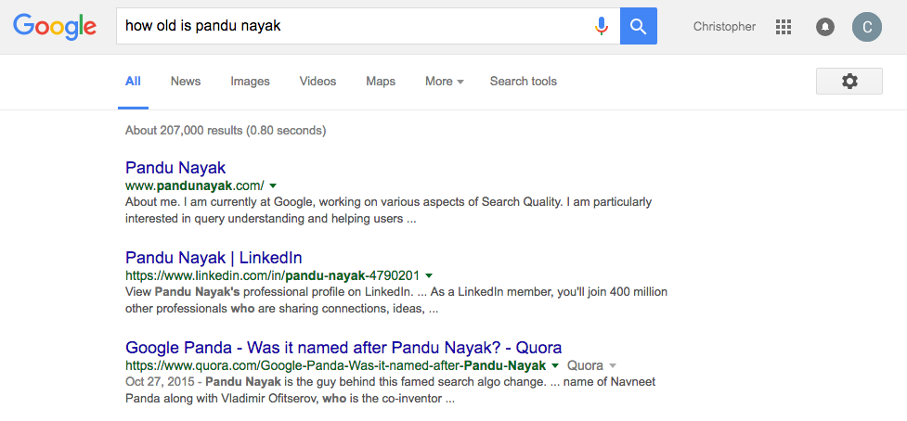

Slide 30
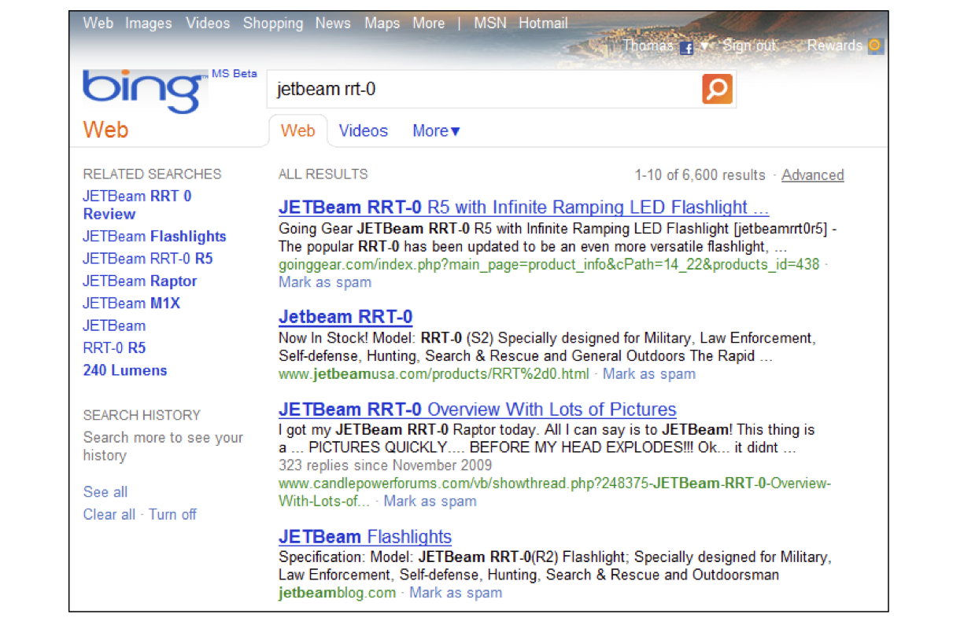
Patrick Pantel talk
(Then) Current experience

Slide 31
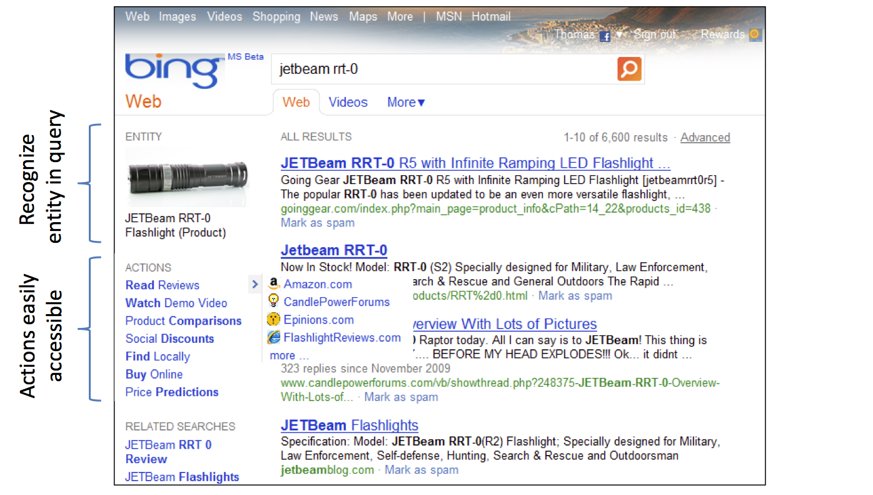
Desired experience: Towards actions

Slide 32
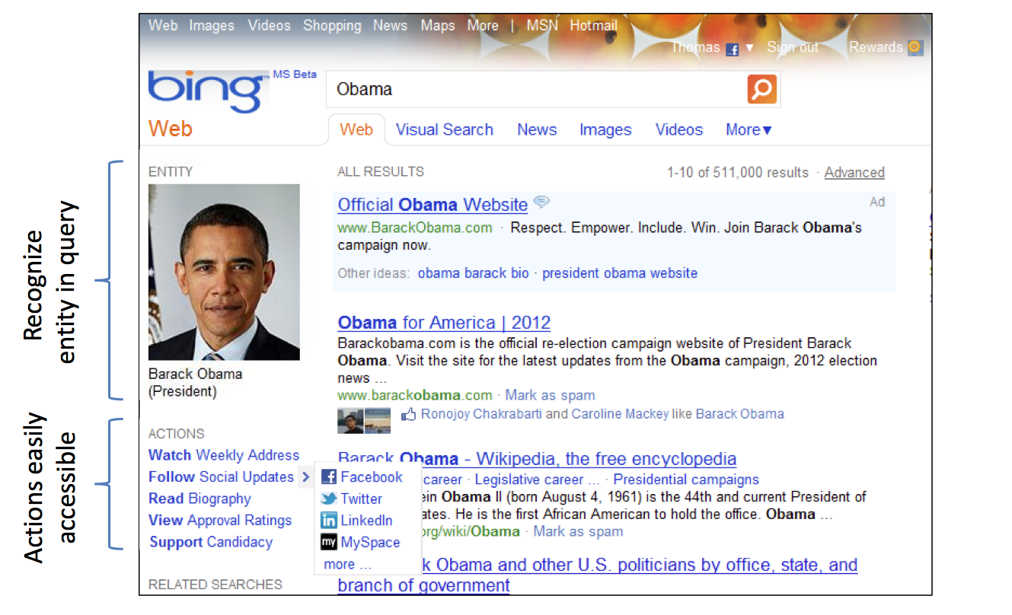
Politician

Slide 33
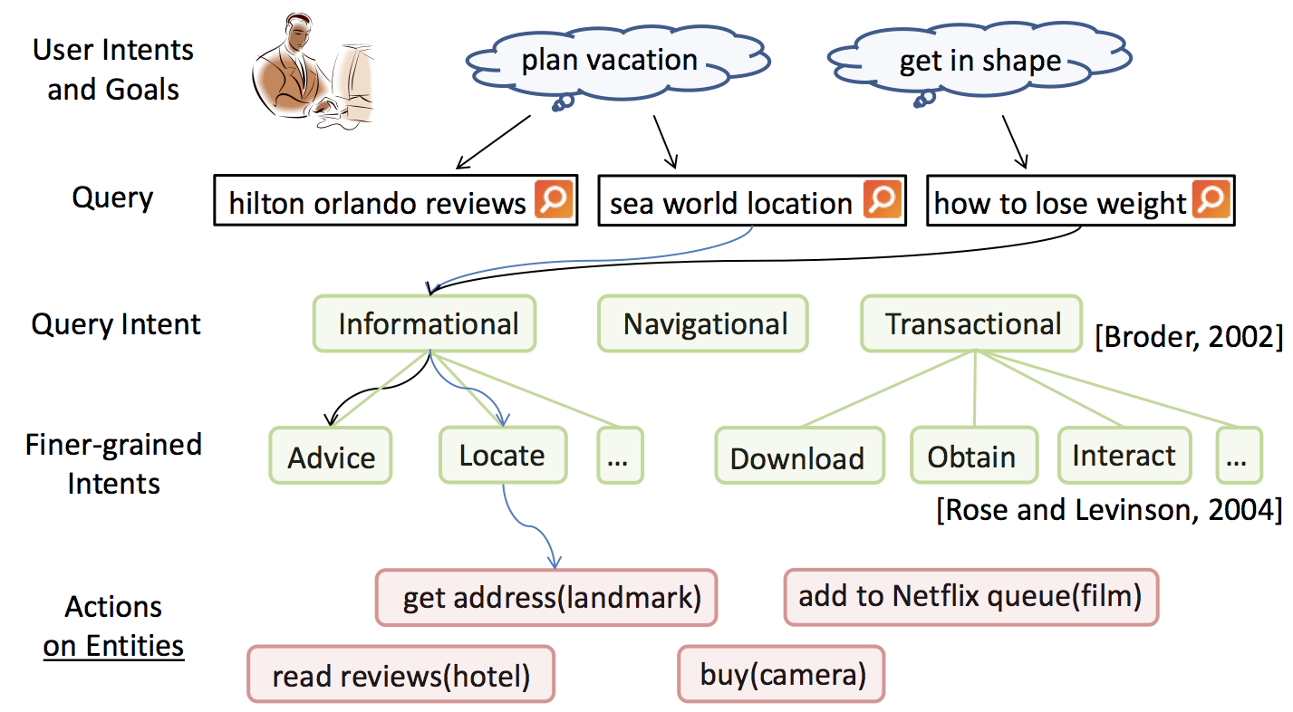
Actions vs. Intents

Slide 34
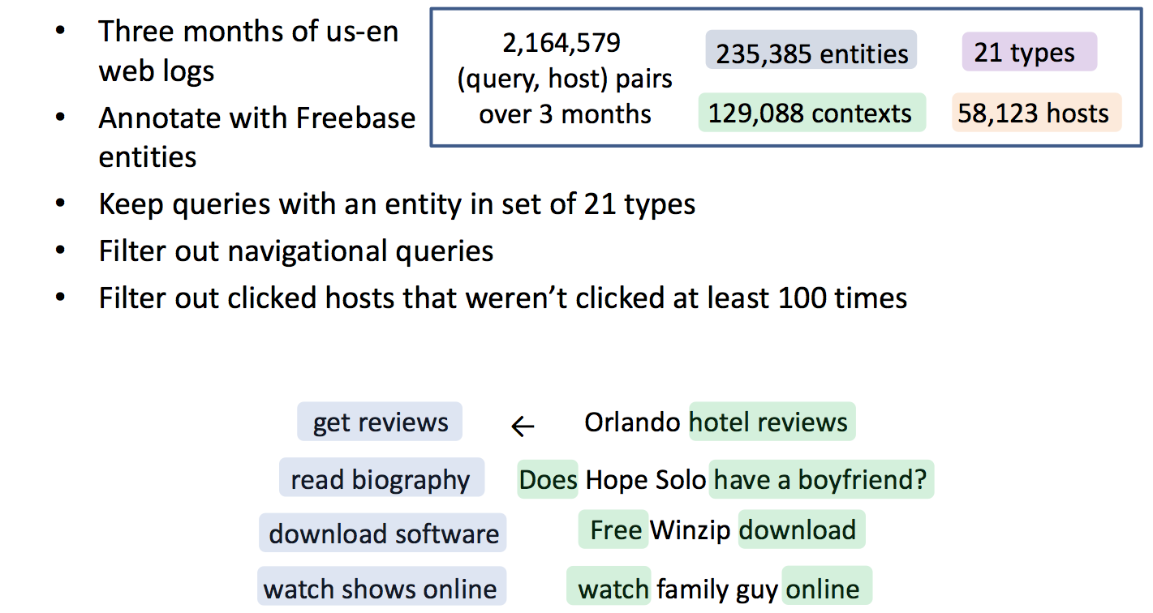
Learning actions from web usage logs
Notes:
Goes off to build probabilistic models that I won’t show….

Slide 35
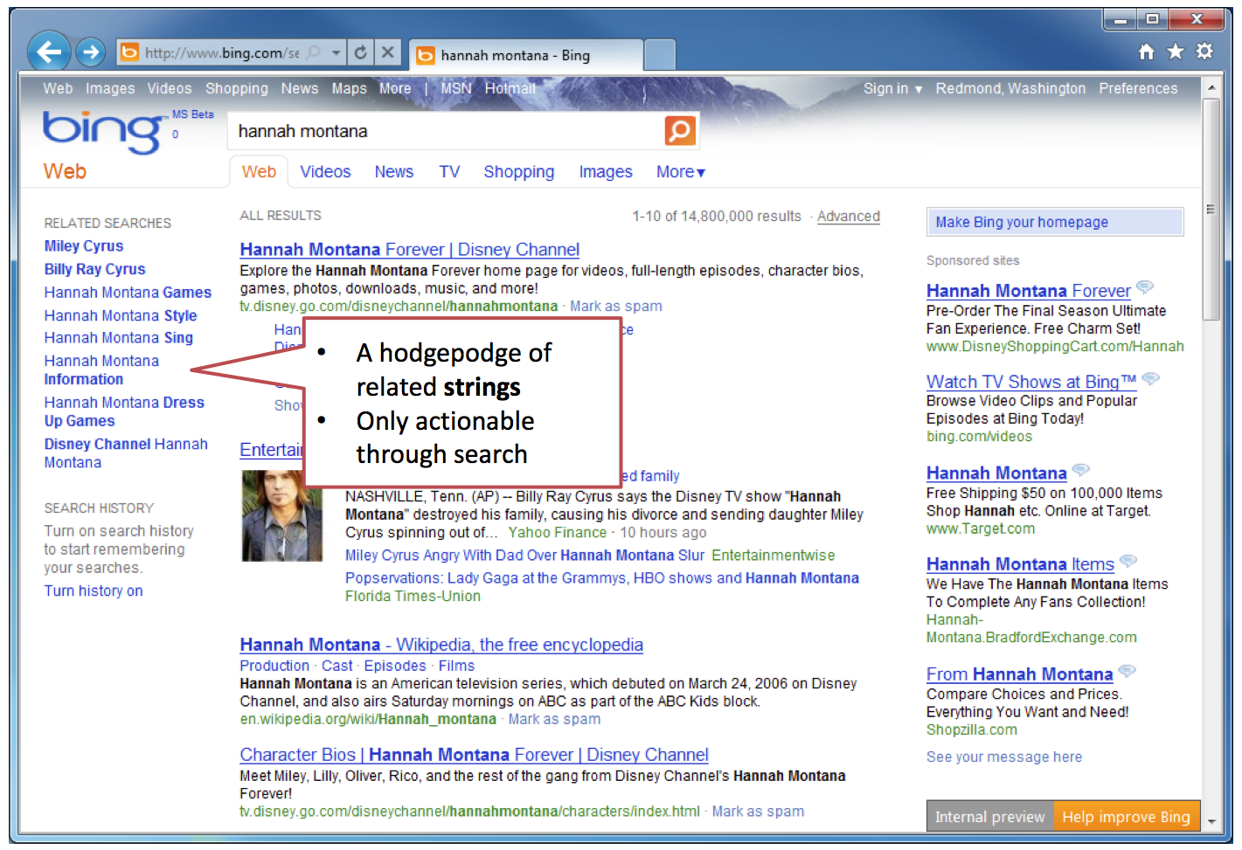
Notes:
A hodgepodge of related strings only actionable through search

Slide 36
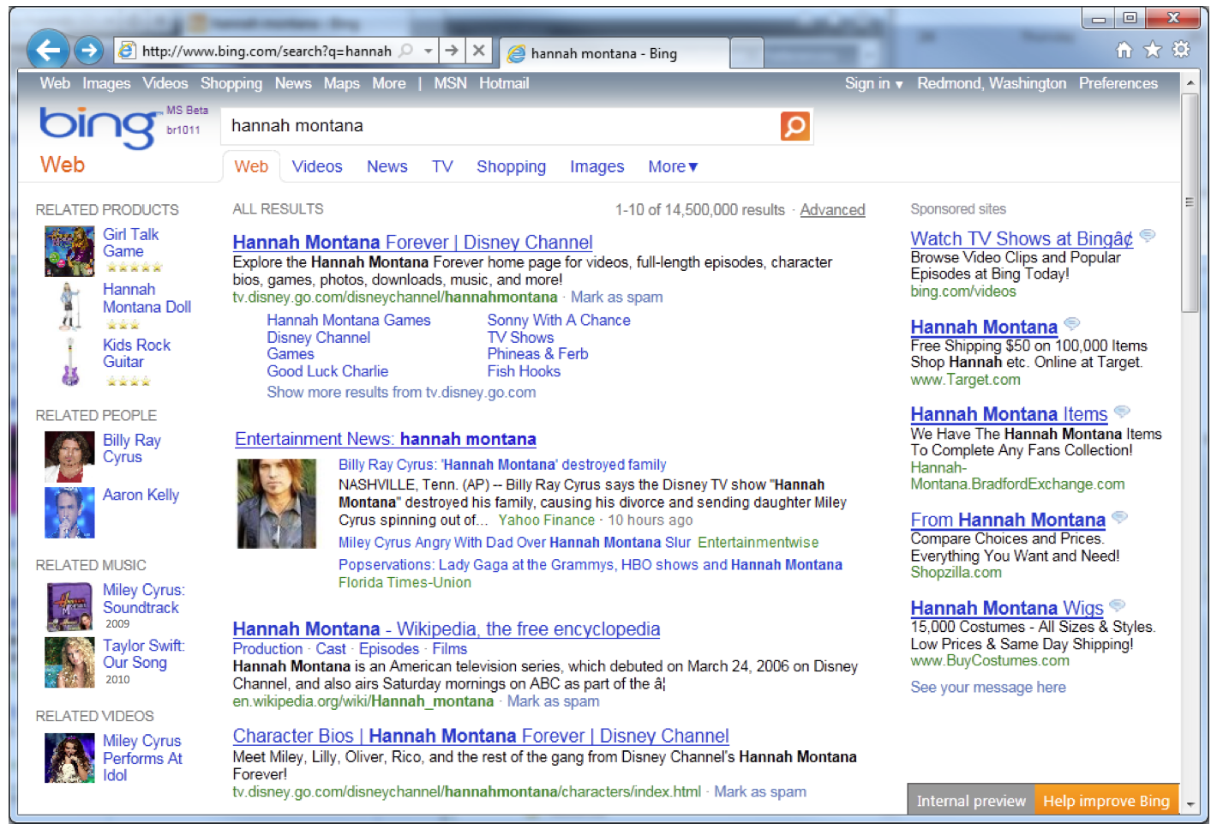

Slide 37
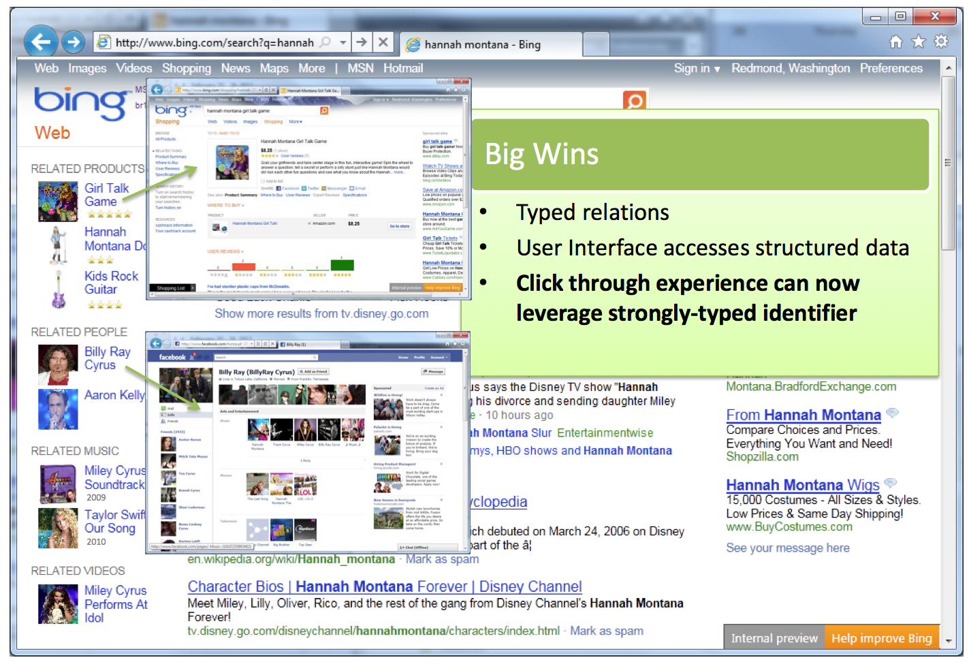

Slide 38
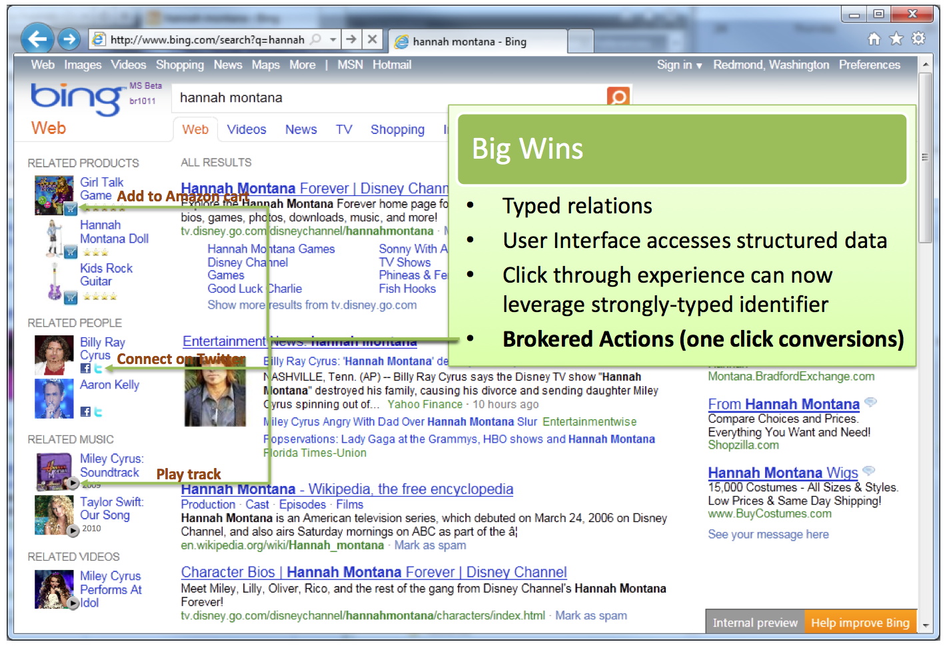

Slide 39
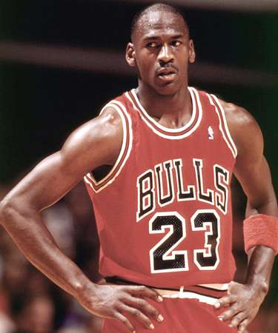
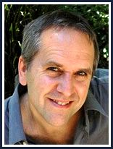
Entity disambiguation and linking
Key requirement is that entities get identified
  Named entity recognition (e.g., Stanford NER!)
and disambiguated
  Entity linking (or sometimes “Wikification”)
    e.g., Michael Jordan the basketballer or the ML guy

Slide 40
Mentions, Meanings, Mappings [G. Weikum]
Eli (bible)
Sergio talked to
Ennio about
Eli‘s role in the
Ecstasy scene.
This sequence on
the graveyard
was a highlight in
Sergio‘s trilogy
of western films.
Eli Wallach
Benny Goodman
?
Ecstasy (drug)
Ecstasy of Gold
Benny Andersson
Star Wars Trilogy
KB
Lord of the Rings
Dollars Trilogy
Sergio means Sergio_Leone
Sergio means Serge_Gainsbourg
Ennio means Ennio_Antonelli
Ennio means Ennio_Morricone
Eli means Eli_(bible)
Eli means ExtremeLightInfrastructure
Eli means Eli_Wallach
Ecstasy means Ecstasy_(drug)
Ecstasy means Ecstasy_of_Gold
trilogy means Star_Wars_Trilogy
trilogy means Lord_of_the_Rings
trilogy means Dollars_Trilogy
… … …
Entities
(meanings)
Mentions
(surface names)
D5 Overview May 30, 2011
Notes:
Disambiguate by bringing together consistent grouping.

Slide 41
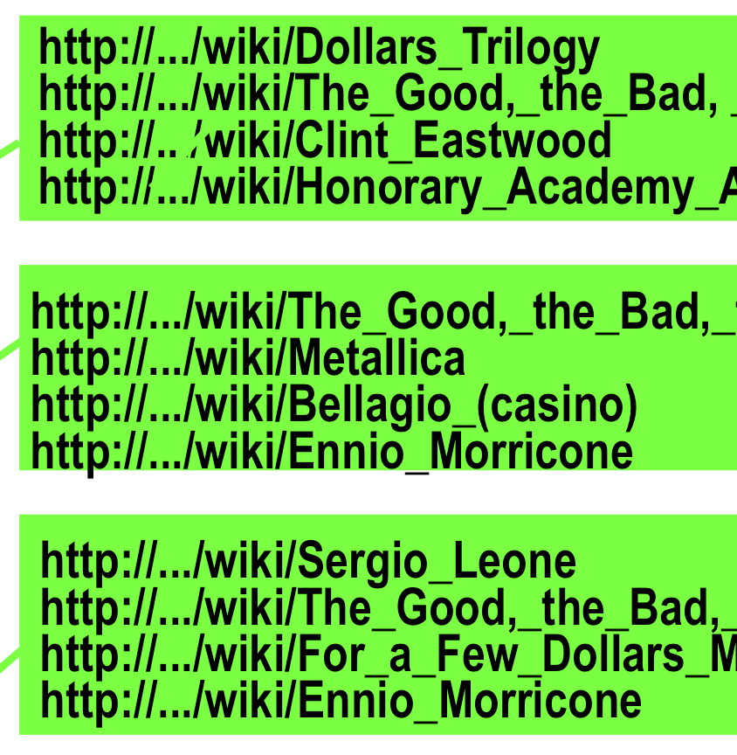
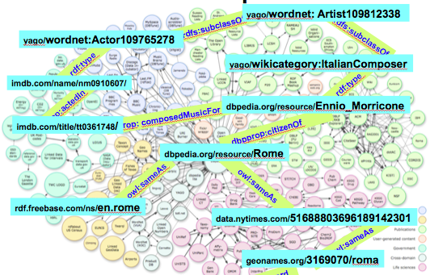
and linked to a canonical reference
  Freebase, dbPedia, Yago2, (WordNet)

Slide 42
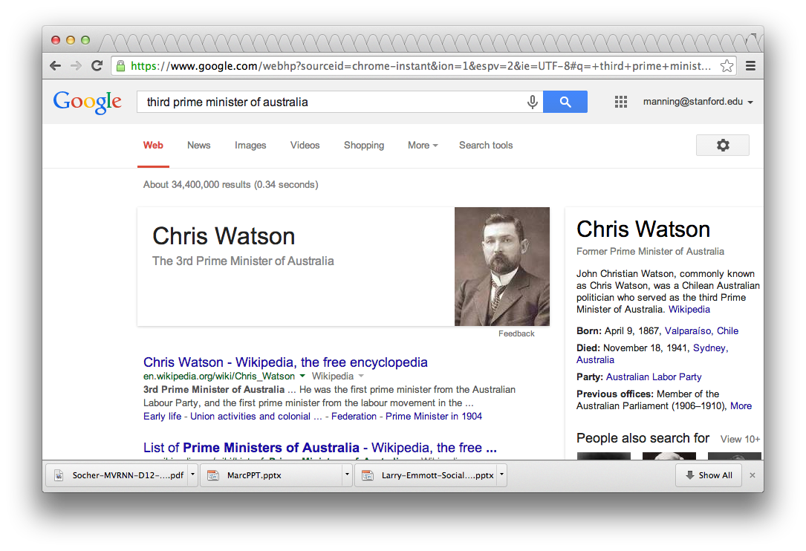
Understanding questions
Notes:
Note that this is a latent question

Slide 43
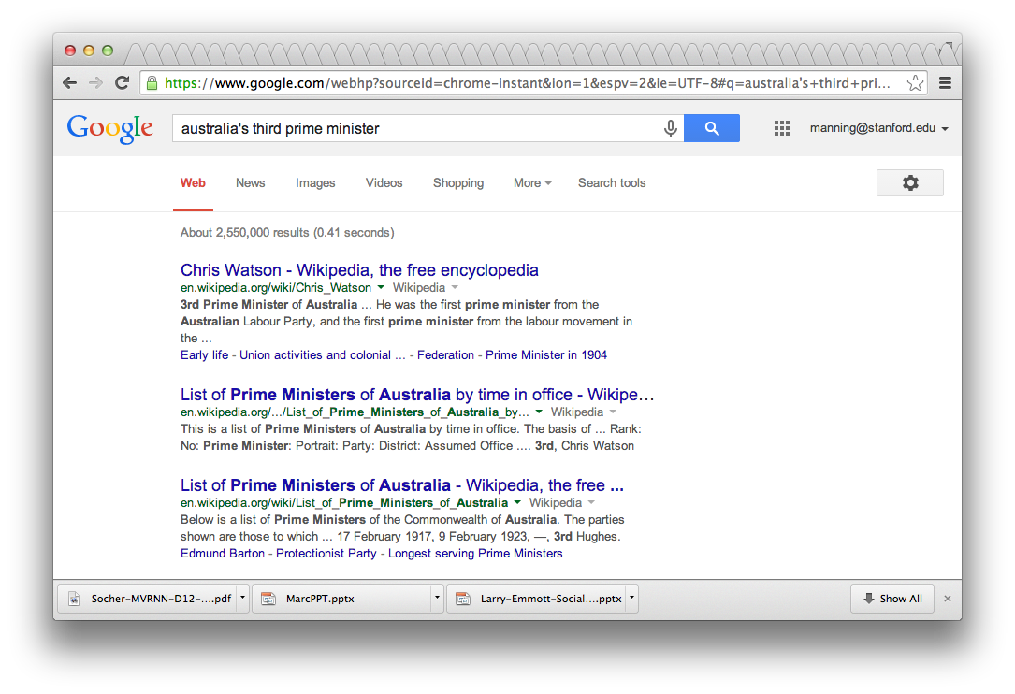

Slide 44
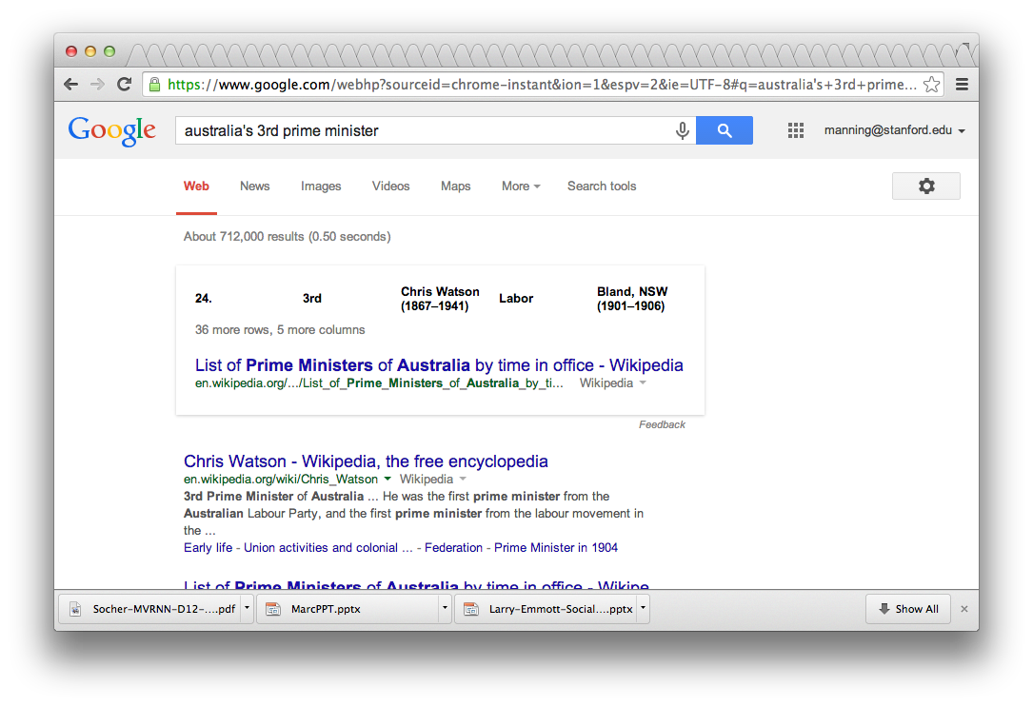

Slide 45
3 approaches to question answering:
Knowledge-based approaches (Siri)
Build a semantic representation of the query
  Times, dates, locations, entities, numeric quantities
Map from this semantics to query structured data or resources
  Geospatial databases
  Ontologies (Wikipedia infoboxes, dbPedia, WordNet, Yago)
  Restaurant review sources and reservation services
  Scientific databases
  Wolfram Alpha

Slide 46
Text-based (mainly factoid) QA
QUESTION PROCESSING
  Detect question type, answer type, focus, relations
  Formulate queries to send to a search engine
PASSAGE RETRIEVAL
  Retrieve ranked documents
  Break into suitable passages and rerank
ANSWER PROCESSING
  Extract candidate answers (as named entities)
  Rank candidates
    using evidence from relations in the text and external sources
Notes:
Do analysis on the fly. Have exact context.
Not good for aggregate questions or information integration.

Slide 47
Hybrid approaches (IBM Watson)
Build a shallow semantic representation of the query
Generate answer candidates using IR methods
  Augmented with ontologies and semi-structured data
Score each candidate using richer knowledge sources
  Geospatial databases
  Temporal reasoning
  Taxonomical classification

Slide 48

Texts are Knowledge
Notes:
Good evening. I’d like to tell you about what computers can now do with material in human languages. We’re finding good ways to get computers to understand human language texts, and a key part of that is having computers knowing enough about the world. Indeed, these two things are related because texts are knowledge.
Have a good first sentence!
Trinity College Library, Dublin. The long room.

Slide 49

Knowledge: Jeremy Zawodny says …
Notes:
20 year olds in 2012 were born in 1992. Can’t remember life before the web! [ex-Yahoo!/Craigslist]
Back in the late 90s when I was building things that passed for knowledge management tools at Marathon Oil, there was all this talk about knowledge workers. These were people who’d have vast quantities of knowledge at their fingertips. All they needed was ways to organize, classify, search, and collaborate.
I think we’ve made it. But the information isn’t organized like I had envisioned a few years ago. It’s just this big ugly mess known as The Web. Lots of pockets of information from mailing lists, weblogs, communities, and company web sites are loosely tied together by hyperlinks. There’s no grand schema or centralized database. There’s little structure or quality control. No global vocabulary.
But even with all that going against it, it’s all indexed and easily searchable thanks largely to Google and the companies that preceded it (Altavista, Yahoo, etc.). Most of the time it actually works. Amazing!

Slide 50
Is the goal to go from language to knowledge bases?
For humans, going from the largely unstructured language on the web to actionable information is effortlessly easy
But for computers, it’s rather difficult!
This has suggested to many that if we’re going to produce the next generation of intelligent agents, which can make decisions on our behalf
  Answering our routine email
  Booking our next trip to Fiji
then we still first need to construct knowledge bases
To go from languages to information
But should we rather just have computers work with language?

Slide 51
Knowledge:
Not just semantics but pragmatics
Pragmatics = taking account of context in determining meaning
A natural part of language understanding and use
Search engines are great because they inherently take into account pragmatics (“associations and contexts”)
  [the national] → The National (a band)
  [the national ohio] → The National - Bloodbuzz Ohio – YouTube
  [the national broadband] → www.broadband.gov
Notes:
Getting your pragmatics for free
Working with texts, it’s easy to pick up on such associations
It’s difficult to get the same sort of easy pragmatics in knowledge bases?

Slide 52
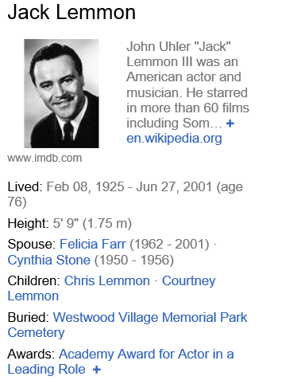
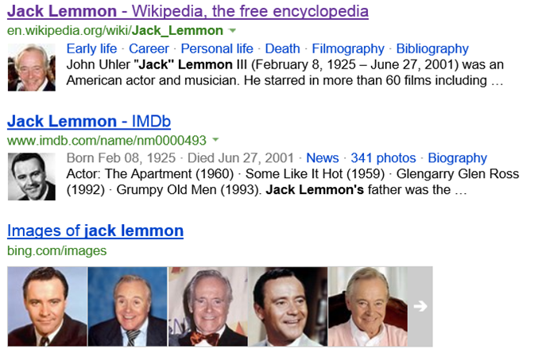
Scott Wen-tau Yih (ACL 2013) paper
Lemmon was awarded the Best Supporting Actor Oscar in 1956 for Mister Roberts (1955) and the Best Actor Oscar for Save the Tiger (1973), becoming the first actor to achieve this rare double…
Source: Jack Lemmon -- Wikipedia
Who won the best actor Oscar in 1973?

Slide 53




Word Alignment for Question Answering TREC QA (1999-2005)
What is the fastest car in the world?
The Jaguar XJ220 is the dearest, fastest and most sought after car on the planet.
[Harabagiu & Moldovan, 2001]
Assume that there is an underlying alignment
  Describes which words in and can be associated
See if the (syntactic/semantic) relations support the answer

Slide 54
Full NLP QA: LCC (Harabagiu/Moldovan) [below is the architecture of LCC’s QA system circa 2003]
Question Processing
Document Processing
Factoid Answer Processing
Single Factoid
Passages
Question Parse
Answer Extraction (NER)
Factoid
Question
Semantic
Transformation
Multiple
List
Passages
Answer Justification
(alignment, relations)
Factoid
Answer
Recognition of
Expected Answer Type (for NER)
Multiple
Definition
Passages
Answer Reranking
List
Question
(~ Theorem Prover)
Passage Retrieval
Axiomatic Knowledge Base
Keyword Extraction
List Answer Processing
List
Answer
Document Index
Named Entity
Recognition
(CICERO LITE)
Answer Type
Hierarchy
(WordNet)
Answer Extraction
Threshold Cutoff
Question Processing
Document
Collection
Definition
Question
Question Parse
Definition Answer Processing
Answer Extraction
Definition
Answer
Pattern Matching
Pattern
Repository
Pattern Matching
Keyword Extraction

Slide 55


DrQA: Open-domain Question Answering
(Chen, et al. ACL 2017) https://arxiv.org/abs/1704.00051

Slide 56

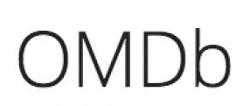
Open-domain Question Answering
SQuAD
Q: How many of Warsaw's inhabitants spoke Polish in 1933? ^{A: 833,500}
TREC
Q: What U.S. state’s motto is “Live free or Die”? ^{A: New Hampshire}
WebQuestions (Berant et al, 2013)
Q: What part of the atom did
Chadwick discover? ^{A: neutron}
WikiMovies (Miller et al, 2016)
Q: Who wrote the film Gigli? ^{A: Martin Brest}

Slide 57
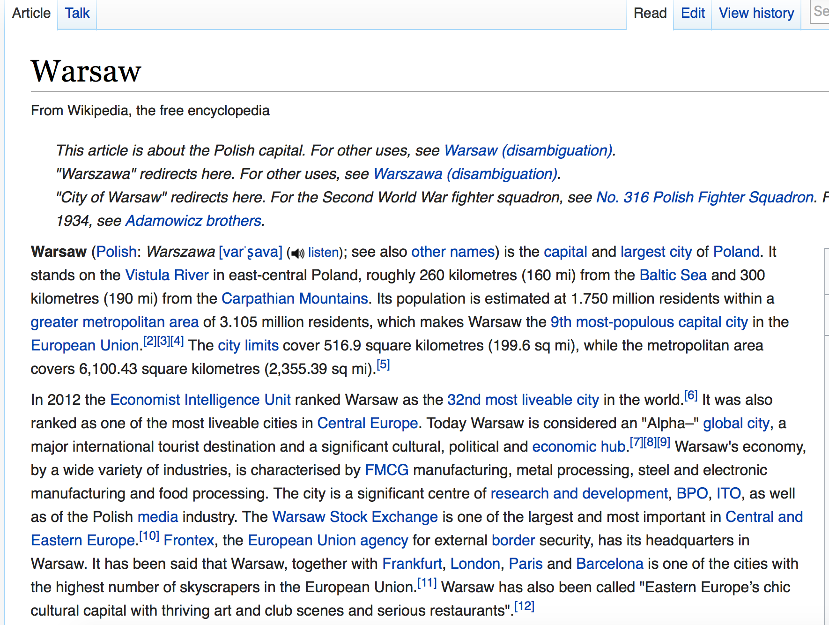

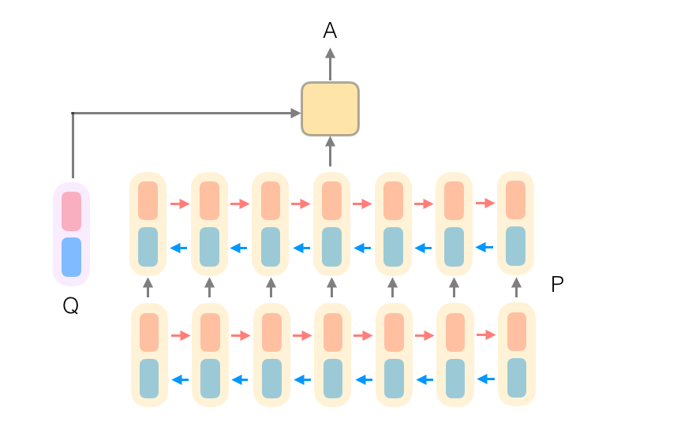
Q: How many of Warsaw's inhabitants
spoke Polish in 1933?
Document
Retriever
Document
Reader
833,500

Slide 58
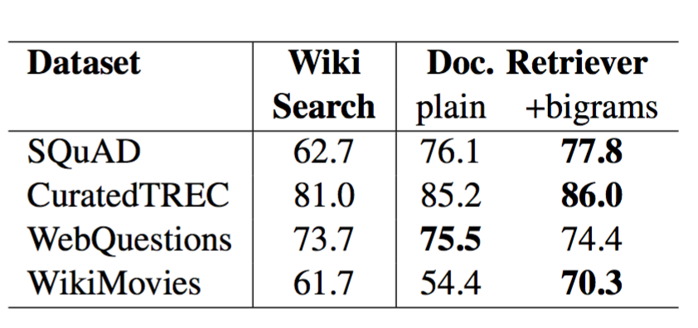
Document Retriever
(Chen et al, 2017)
Traditional tf.idf inverted index + efficient bigram hash
70-86% of questions we have that the answer segment appears in the top 5 articles

Slide 59
Document Reader:
Stanford Attentive Reader
(Chen et al, 2016)
Q
characters in " @placeholder " movies have gradually become more diverse
Bidirectional LSTMs
…
…
…
characters
in
“
@placeholder
more
diverse

Slide 60
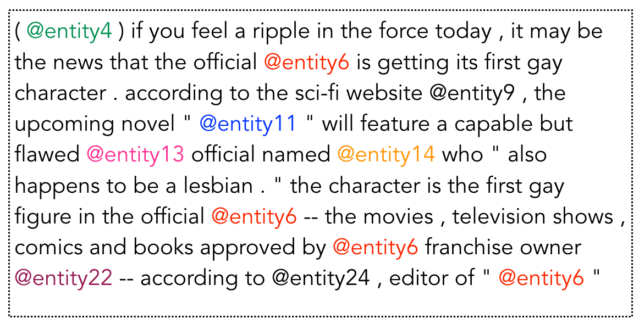
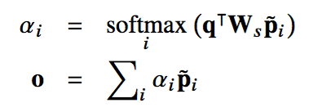

Stanford Attentive Reader
(Chen et al, 2016)
Q
characters in " @placeholder " movies have gradually become more diverse
Bidirectional LSTMs
P
…
…
…
Attention
A
entity6

Slide 61
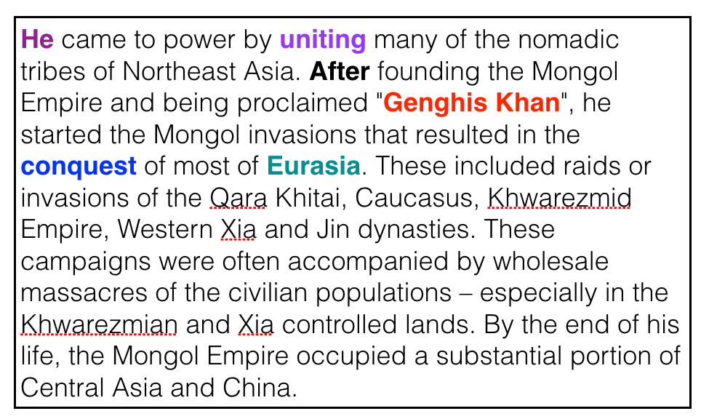

Stanford Attentive Reader++
Q
Who did Genghis Khan unite before he began conquering the rest of Eurasia?
Bidirectional RNNs
P
…
…
…
Attention
Attention
predict start token
predict end token

Slide 62
Results (single model)
(Chen et al, 2017)
 | F1
Logistic regression | 51.0
Fine-Grained Gating (Carnegie Mellon U) | 73.3
Match-LSTM (Singapore Management U) | 73.7
DCN (Salesforce) | 75.9
BiDAF (UW & Allen Institute) | 77.3
Multi-Perspective Matching (IBM) | 78.7
ReasoNet (MSR Redmond) | 79.4
DrQA (Chen et al. 2017) | 79.4
r-net (MSR Asia) | 80.8
Human performance | 91.2

Slide 63
Results
(Chen et al, 2017)
Exact match
(top-1 prediction)
Notes:
In terms of the parsing speed, our parser is like twice faster than MaltParser, and more than 50 times faster than MSTParser.

Slide 64
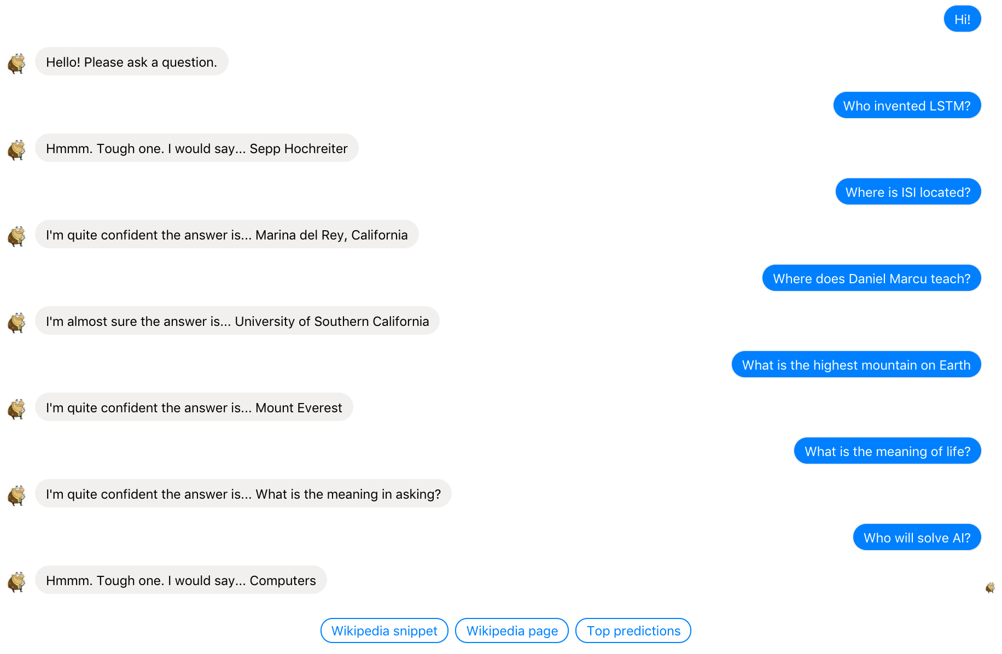
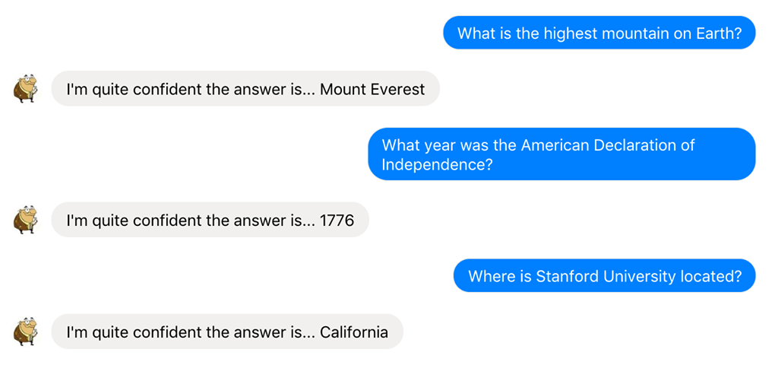
Demo
Notes:
In terms of the parsing speed, our parser is like twice faster than MaltParser, and more than 50 times faster than MSTParser.

Slide 65
Demo
Notes:
In terms of the parsing speed, our parser is like twice faster than MaltParser, and more than 50 times faster than MSTParser.

Slide 66
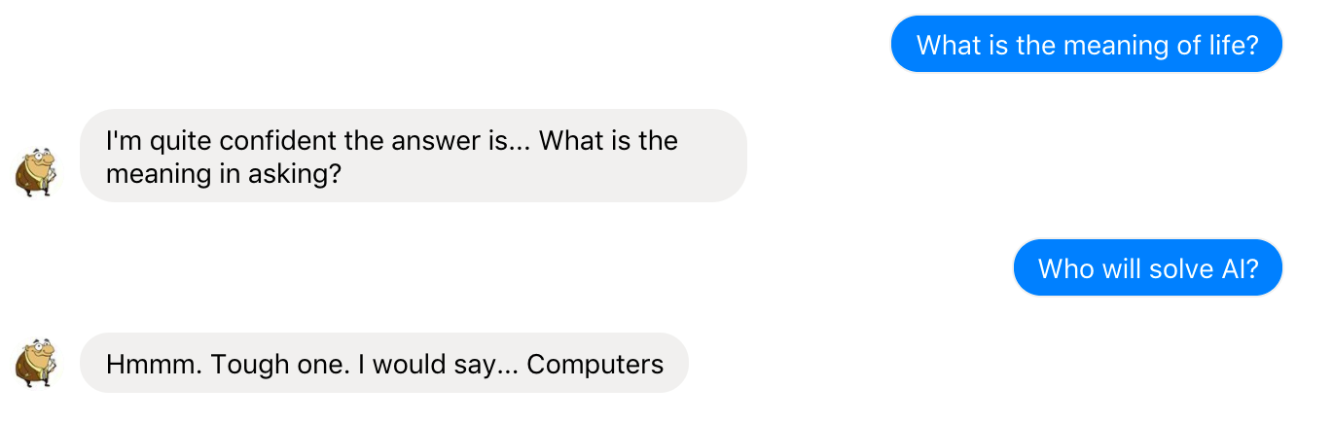
Demo
Notes:
In terms of the parsing speed, our parser is like twice faster than MaltParser, and more than 50 times faster than MSTParser.

Slide 67


Thanks everyone! ☺

