Slide 1
Light and shading
P. Claesz, Still Life with a Skull and a Writing Quill, 1628

Slide 2
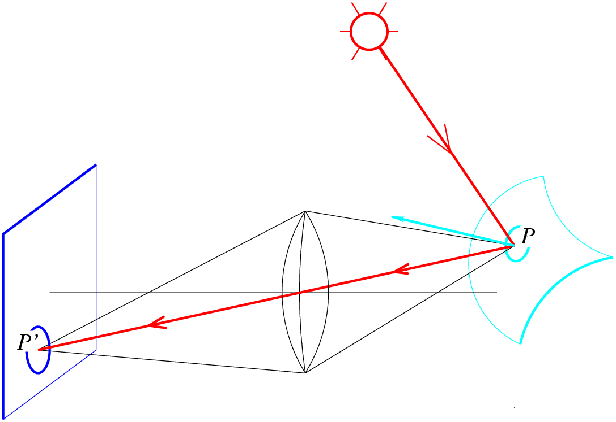
Image formation
What determines the brightness of an image pixel?
Distribution and properties of light sources
Surface reflectance
properties
Sensor properties
Exposure
Surface
shape and orientation
Optics
Slide by L. Fei-Fei
Notes:
Review slide (skip)

Slide 3
Outline
Small taste of radiometry
In-camera transformation of light
Reflectance properties of surfaces
Diffuse and specular reflection
Shape from shading
Estimating direction of light sources

Slide 4

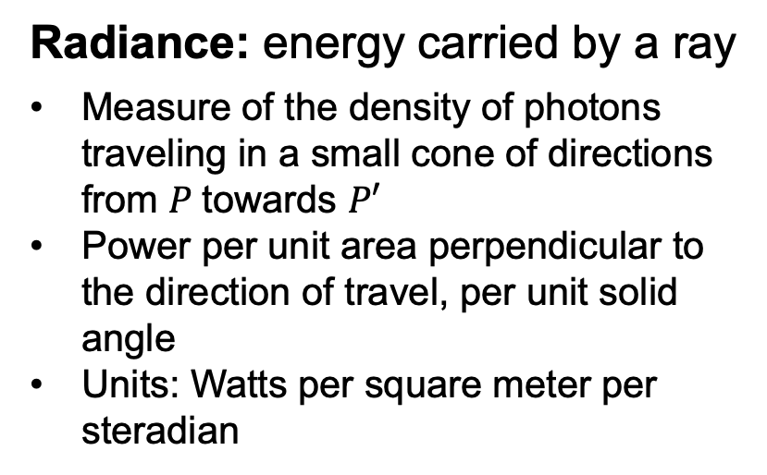



Radiometry of image formation
$$L$$
P
$$E$$
Radiance: energy carried by a ray
Measure of the density of photons traveling in a small cone of directions from $P$towards $P′$
Power per unit area perpendicular to the direction of travel, per unit solid angle
Units: Watts per square meter per steradian
$$P′$$
Irradiance: energy arriving at a surface
Incident power per unit area (not foreshortened)
Units: Watts per square meter
What is the relationship between $E$ and $L$?

Slide 5
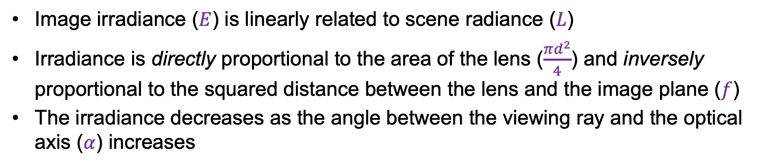
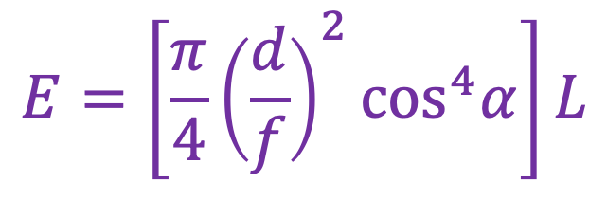

Fundamental radiometric relation
P
$$E=\left[\frac{π}{4}{\left(\frac{d}{f}\right)}^{2}\cos^{4}α\right]L$$
d
α
$$P′$$
f
z
Image irradiance ($E$) is linearly related to scene radiance ($L$)
Irradiance is directly proportional to the area of the lens ($\frac{πd^{2}}{4}$) and inversely proportional to the squared distance between the lens and the image plane ($f$)
The irradiance decreases as the angle between the viewing ray and the optical axis ($α$) increases
For derivation, see, e.g., Szeliski 2.2.3
Notes:
Difference between the cos^4 alpha effect and mechanical vignetting: the former effect has nothing to do with light getting lost in the lens system but is a basic radiometric property even of a perfect lens; mechanical vignetting is usually much stronger.

Slide 6

Fundamental radiometric relation
$$E=\left[\frac{π}{4}{\left(\frac{d}{f}\right)}^{2}\cos^{4}α\right]L$$
S. B. Kang and R. Weiss. Can we calibrate a camera using an image of a flat, textureless Lambertian surface? ECCV 2000
Notes:
The brightest point corresponds to the principal point (where the optical axis intersects the image plane). The shape of the curves of constant brightness tells us about the shape (scaling factors) of the pixels. The equation also includes the focal length (z’). Thus, we can in principle figure out all the intrinsic camera parameters using the constraints given by this equation (fundamental radiometric relation).

Slide 7
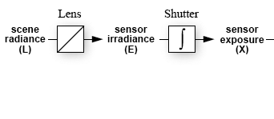
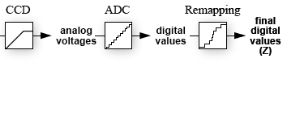


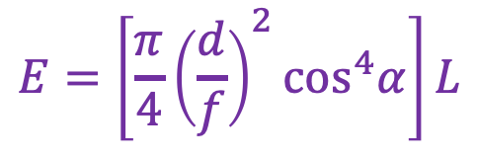
From light rays to pixel values
$$X=E∙∆t$$
$$E=\left[\frac{π}{4}{\left(\frac{d}{f}\right)}^{2}\cos^{4}α\right]L$$
$$Z=f\left(E∙∆t\right)$$
Camera response function: the mapping f from irradiance to pixel values
  Needed for applications like estimation of scene reflectance properties, creating high dynamic range (HDR) images
  For further reading: M. Brown, Understanding the In-Camera Image Processing Pipeline for Computer Vision, CVPR 2016 Tutorial
  Figure source: P. Debevec and J. Malik. Recovering High Dynamic Range Radiance Maps from Photographs. SIGGRAPH 1997
Notes:
Chakrabarti, Scharstein, and Zickler (BMVC 2009) on the remapping process:
“the camera modiﬁes the tristimulus values so that they ﬁt
within the limited gamut and dynamic range of the output color space, and it does so in a way
that is most visually pleasing (as opposed to most accurate). Referred to as color rendering,
this is a proprietary art that may include luminance histogram analysis, corrections to hue
and saturation, and even local corrections for things such as skin tones. In most cases,
this nonlinear color rendering process is scene-dependent and is not a ﬁxed property of a
camera.”

Slide 8
Outline
Small taste of radiometry
In-camera transformation of light
Reflectance properties of surfaces

Slide 9
Recall: Image formation
What determines the brightness of an image pixel?
Distribution and properties of light sources
Surface reflectance
properties
Sensor properties
Exposure
Surface
shape and orientation
Optics
Slide by L. Fei-Fei
Notes:
Review slide (skip)

Slide 10
What can happen to light when it hits a surface?
incoming light
surface

Slide 11
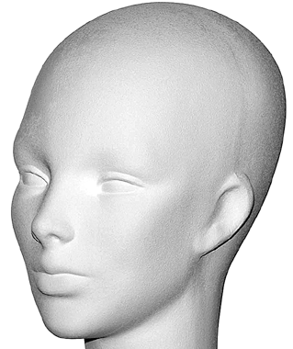
Basic models of reflection
Specular reflection: light is reflected
about the surface normal
Diffuse reflection: light scatters
equally in all directions
incoming light
incoming light
Slide from D. Hoiem

Slide 12

Other possible effects
Transparency
Refraction
Slide from D. Hoiem

Slide 13
Other possible effects
Subsurface scattering
Slide from D. Hoiem
Image source

Slide 14




Other possible effects
Fluorescence
Phosphorescence
$$λ1$$
$$λ2$$
$$t=1$$
$$t>1$$
Slide from D. Hoiem
Image source
Notes:
Fluorescence is light energy produced by a process where high-energy radiation (such as ultraviolet or X-ray) is absorbed by electrons surrounding an atom and is re-emitted as light energy. Unlike fluorescence, a phosphorescent material does not immediately re-emit the radiation it absorbs.
From https://www.pharmatutor.org/pharma-analysis/define-fluorescence-and-phosphorescence

Slide 15
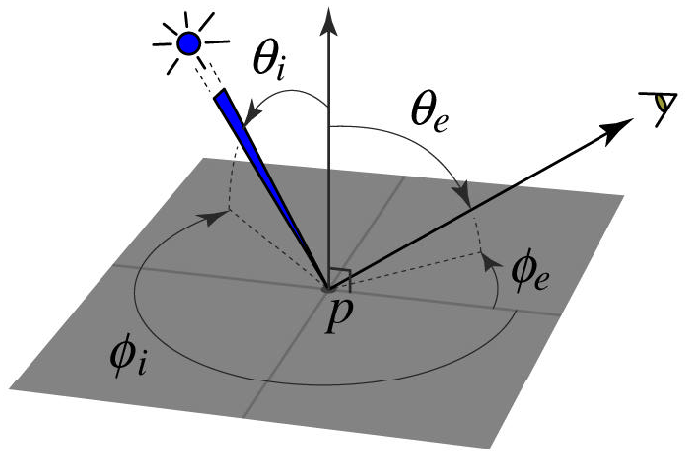
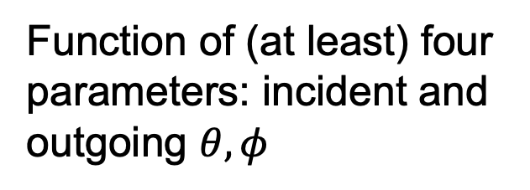
Bidirectional reflectance distribution function (BRDF)
How bright a surface appears when viewed from one direction when light falls on it from another
Definition: ratio of the radiance in the emitted direction to irradiance in the incident direction
Function of (at least) four parameters: incident and outgoing $θ, φ$
Source: Steve Seitz

Slide 16
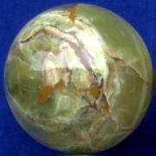
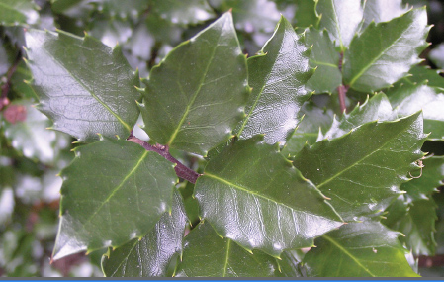
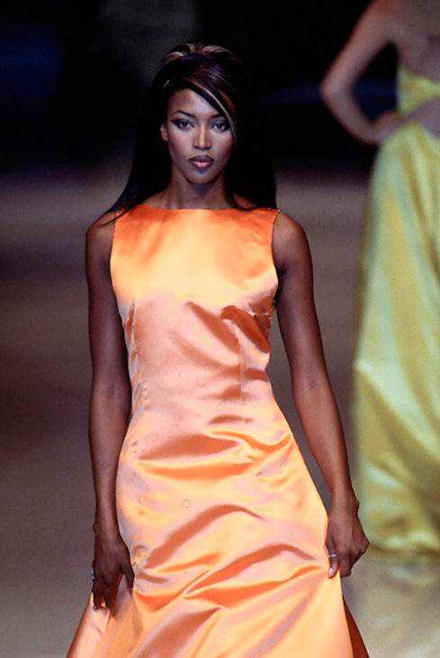

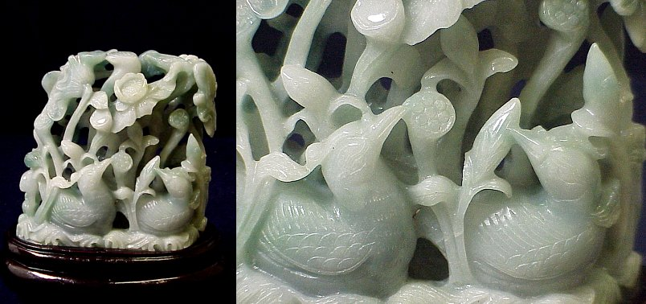

Bidirectional reflectance distribution function (BRDF)
How bright a surface appears when viewed from one direction when light falls on it from another
Definition: ratio of the radiance in the emitted direction to irradiance in the incident direction
Can be incredibly complicated!

Slide 17
Basic models of reflection in detail
Specular reflection: light is reflected
about the surface normal
Diffuse reflection: light scatters
equally in all directions
incoming light
incoming light
Slide from D. Hoiem

Slide 18
Specular reflection
Radiation arriving along a source direction leaves along the specular direction (source direction reflected about normal)

Slide 19
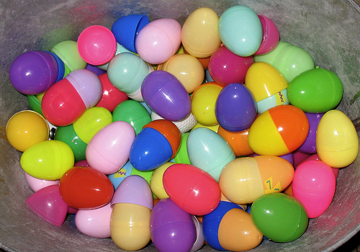
Specular reflection
Radiation arriving along a source direction leaves along the specular direction (source direction reflected about normal)
On real surfaces, energy usually goes into a “lobe” of directions

Slide 20
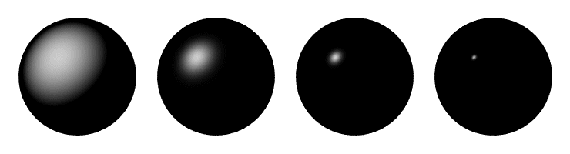
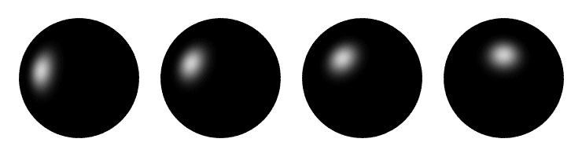
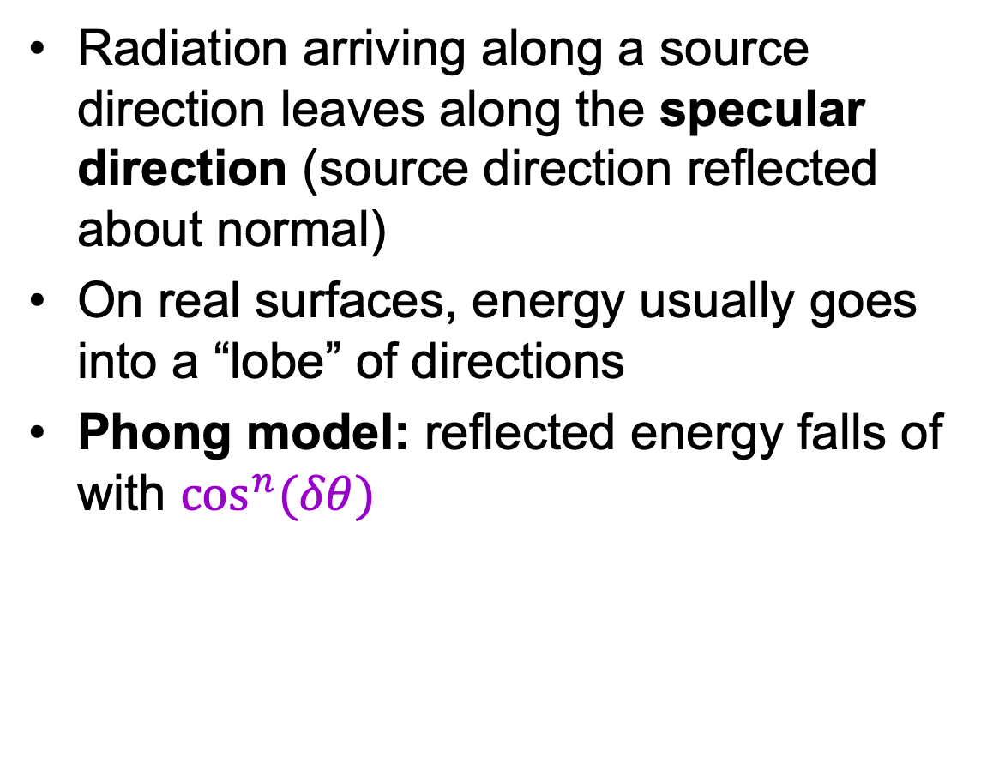

Specular reflection
Radiation arriving along a source direction leaves along the specular direction (source direction reflected about normal)
On real surfaces, energy usually goes into a “lobe” of directions
Phong model: reflected energy falls of with $\cos^{n}(δθ)$
$$δθ$$
Changing the exponent
Moving the light source

Slide 21
Diffuse reflectance
Light scatters equally in all directions
  E.g., brick, matte plastic, rough wood

Slide 22
Diffuse reflectance
Light scatters equally in all directions
  E.g., brick, matte plastic, rough wood
This happens because of microfacets
that scatter incoming light randomly
Image source

Slide 23
Diffuse reflectance
Light scatters equally in all directions
  For a fixed incidence angle, BRDF is constant
What if we change the incidence angle?

Slide 24
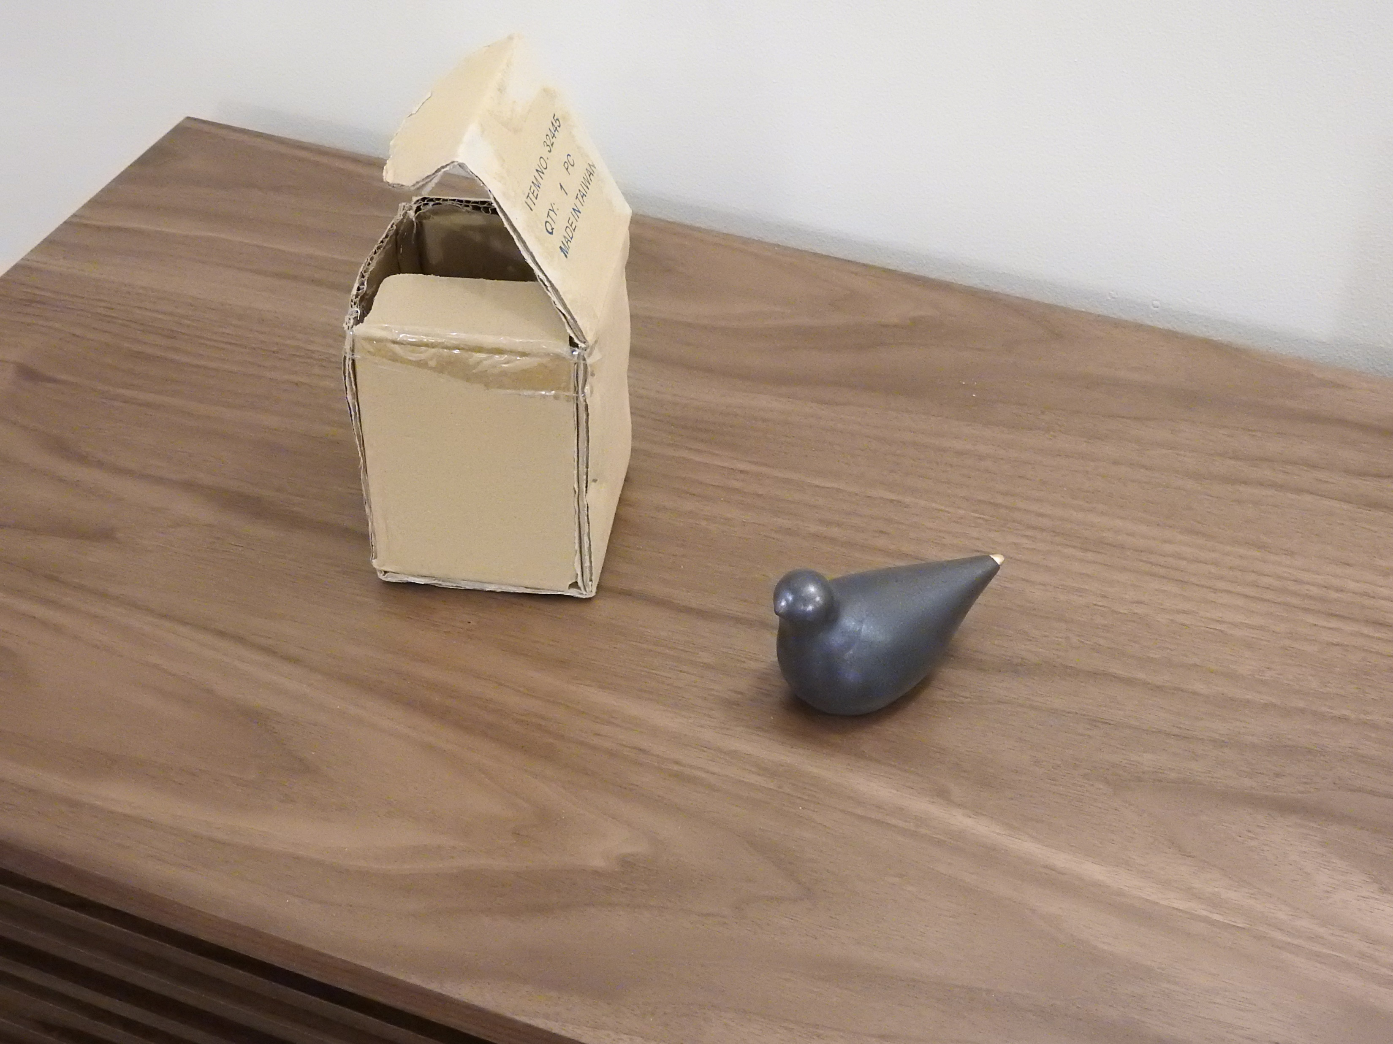

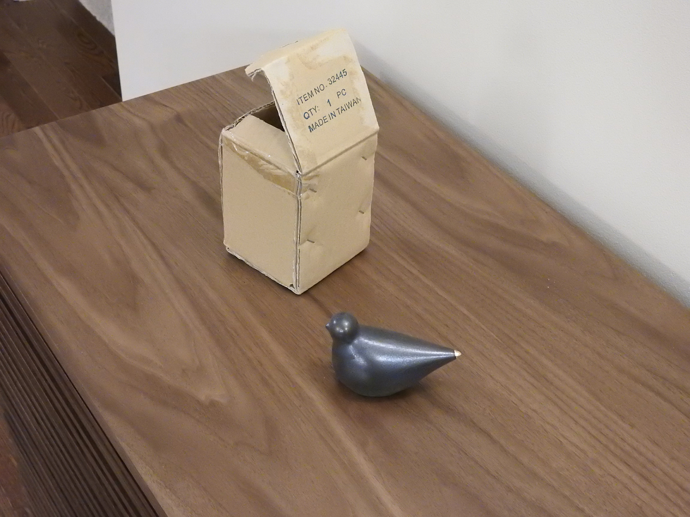
Why do we care about diffuse reflectance?
Same lighting, as close as possible camera settings, but different camera position
Diffuse
Specular
Same appearance
Totally different appearance
Source: J. Johnson and D. Fouhey

Slide 25

Diffuse reflectance
Light scatters equally in all directions
  For a fixed incidence angle, BRDF is constant
What if we change the incidence angle?
brighter
darker

Slide 26
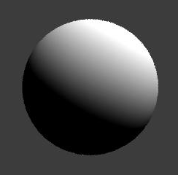


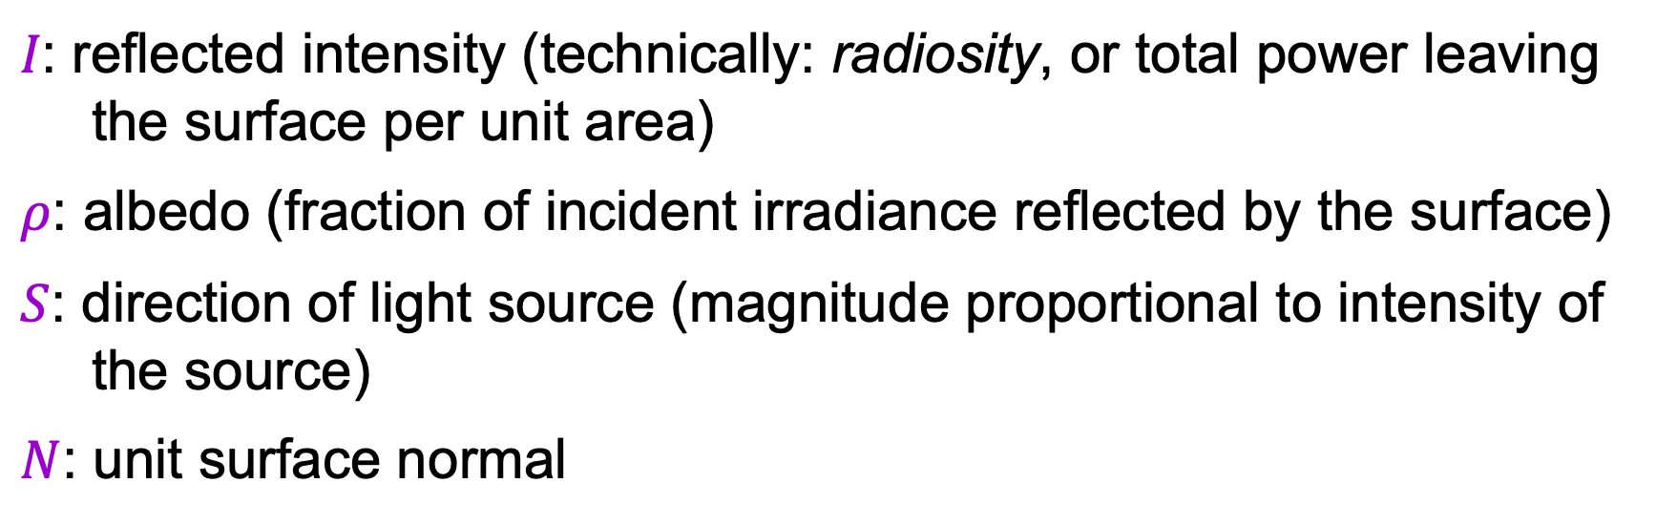
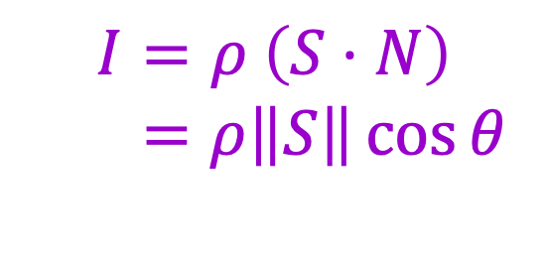
Diffuse reflectance: Lambert’s law
$$N$$
$$I=ρ \left(S⋅N\right)$$
$$=ρ\left\|S\right\|\cos{θ}$$
$$S$$
θ
$I\text{: }\text{reflected} \text{intensity}$ (technically: radiosity, or total power leaving the surface per unit area)
$ρ$: albedo (fraction of incident irradiance reflected by the surface)
$S$: direction of light source (magnitude proportional to intensity of the source)
$N$: unit surface normal
Notes:
BRDF is constant
Albedo: fraction of incident irradiance reflected by the surface
Radiosity: total power leaving the surface per unit area (regardless of direction)

Slide 27
Outline
Small taste of radiometry
In-camera transformation of light
Reflectance properties of surfaces
Diffuse and specular reflection
Shape from shading

Slide 28
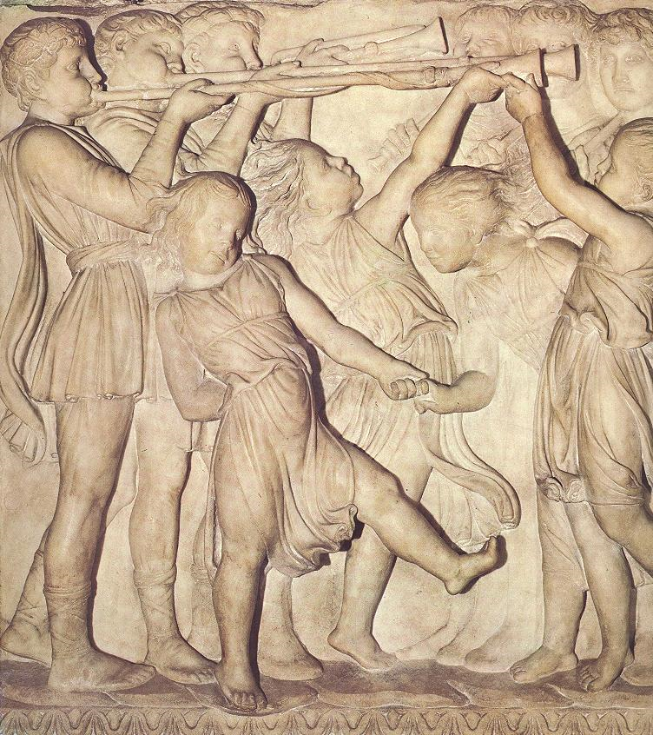
Photometric stereo, or shape from shading
Can we reconstruct the shape of an object based on shading cues?
Luca della Robbia,
Cantoria, 1438

Slide 29


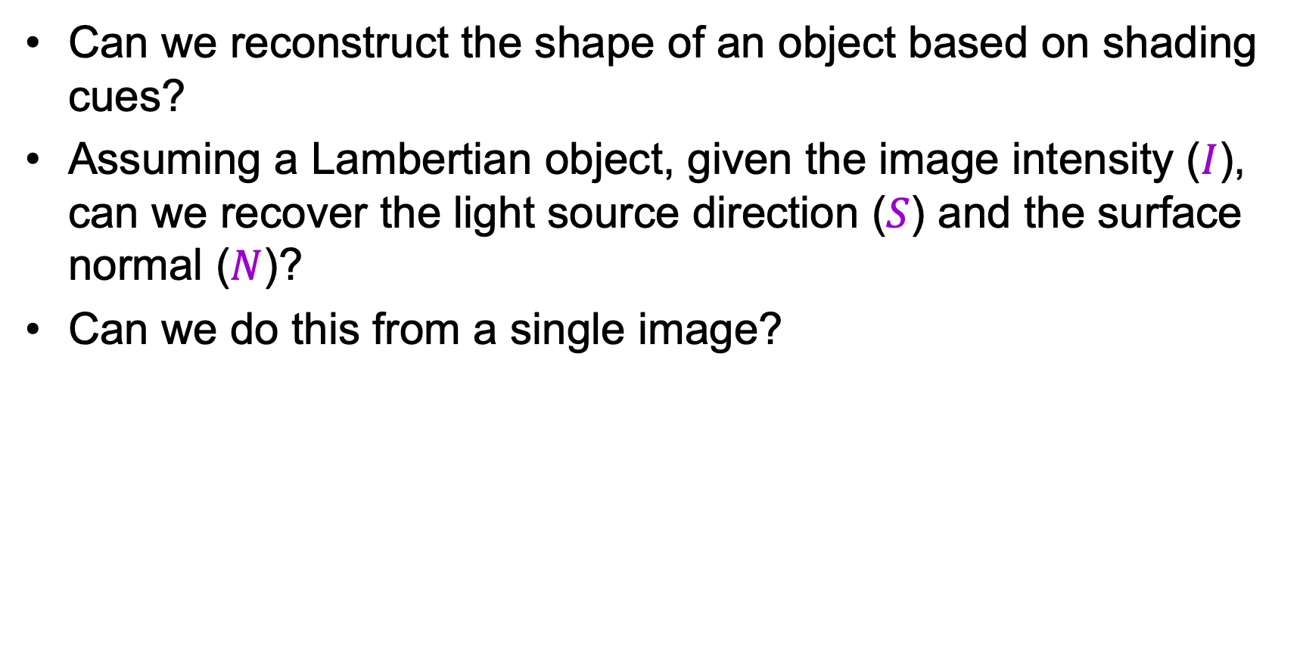

Photometric stereo, or shape from shading
Can we reconstruct the shape of an object based on shading cues?
Assuming a Lambertian object, given the image intensity ($I$), can we recover the light source direction ($S$) and the surface normal ($N$)?
Can we do this from a single image?
$$N$$
$$I=ρ \left(S⋅N\right)$$
$$=ρ\left\|S\right\|\cos{θ}$$
$$S$$
θ

Slide 30
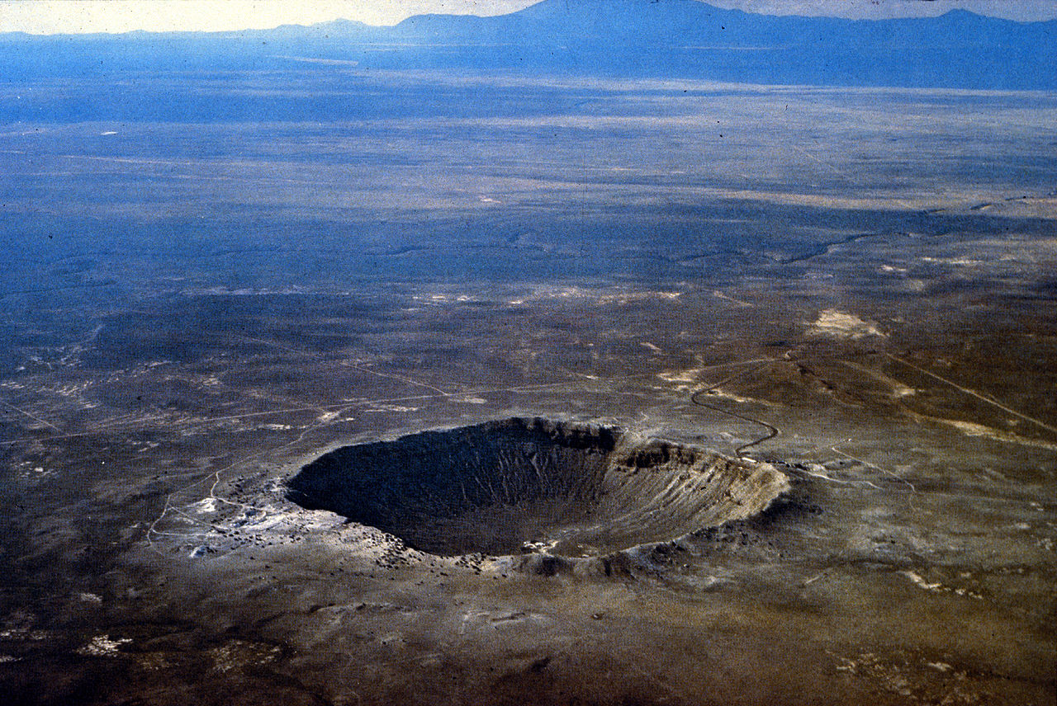
Shape from shading ambiguity
Source: J. Johnson and D. Fouhey
Image source

Slide 31
Shape from shading ambiguity
Humans assume light from above (and the blueness also tells you distance)
Source: J. Johnson and D. Fouhey
Image source

Slide 32
Last time: Light and shading
Small taste of radiometry
In-camera transformation of light
Reflectance properties of surfaces
Diffuse and specular reflection
Shape from shading

Slide 33
Review: Lambert’s law
What determines the observed brightness at a point on the surface?
$$N$$
$$I=ρ \left(S⋅N\right)$$
$$=ρ\left\|S\right\|\cos{θ}$$
$$S$$
θ

Slide 34



Photometric stereo
Assume:
  A Lambertian object
  A local shading model (each point on a surface receives light only from sources visible at that point)
  A set of known light source directions
  A set of pictures of an object, obtained in exactly the same camera/object configuration but using different sources
  Orthographic projection
Goal: reconstruct object shape and albedo
$$S2$$
$$Sn$$
$$S1$$
???
F&P 2nd ed., sec. 2.2.4

Slide 35
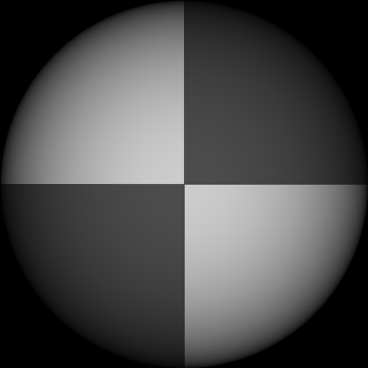
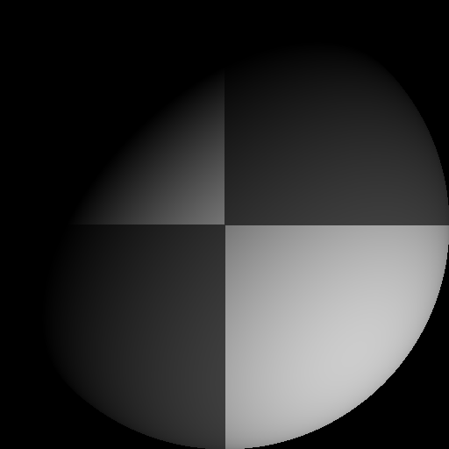
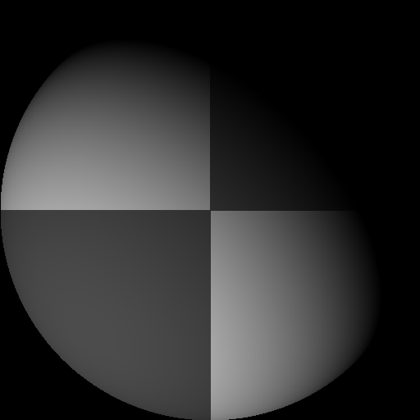
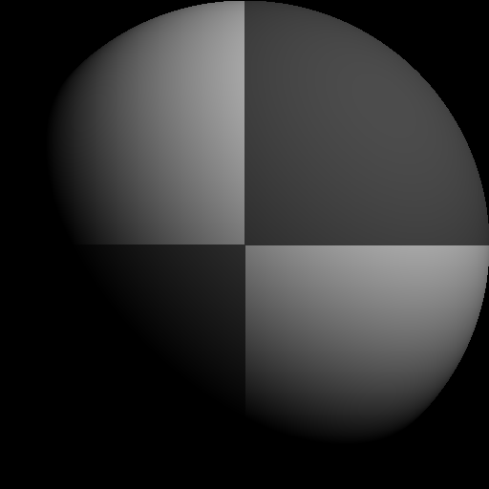
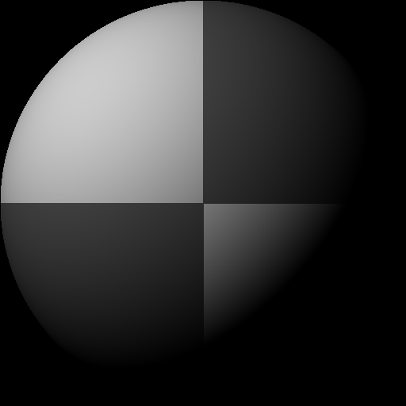
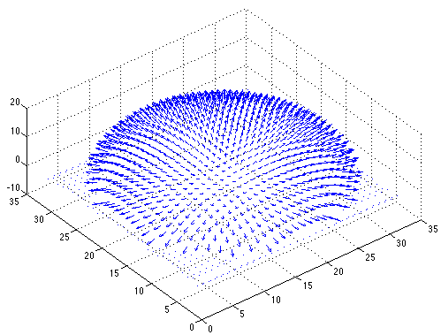
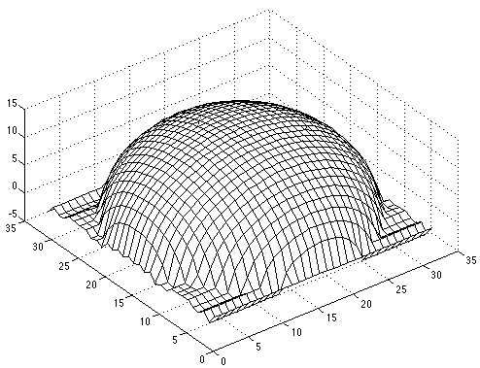

Synthetic example
Recovered albedo
Recovered normal field
Recovered surface model
F&P 2nd ed., sec. 2.2.4

Slide 36
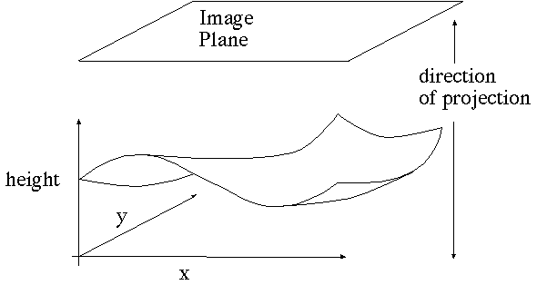
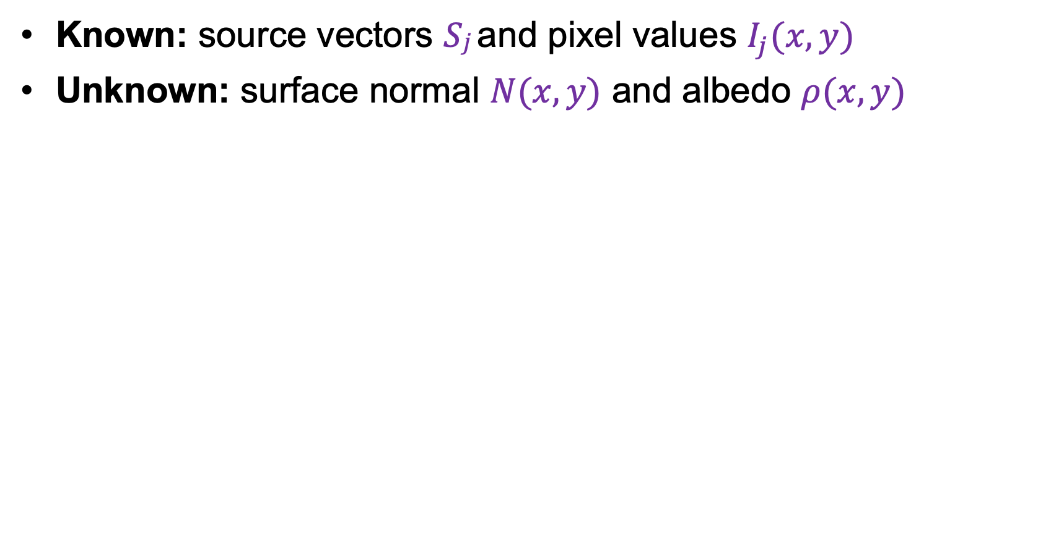
Image model
Known: source vectors $Sj$and pixel values $I_{j}(x,y)$
Unknown: surface normal $N(x,y)$ and albedo $ρ(x,y)$
F&P 2nd ed., sec. 2.2.4

Slide 37
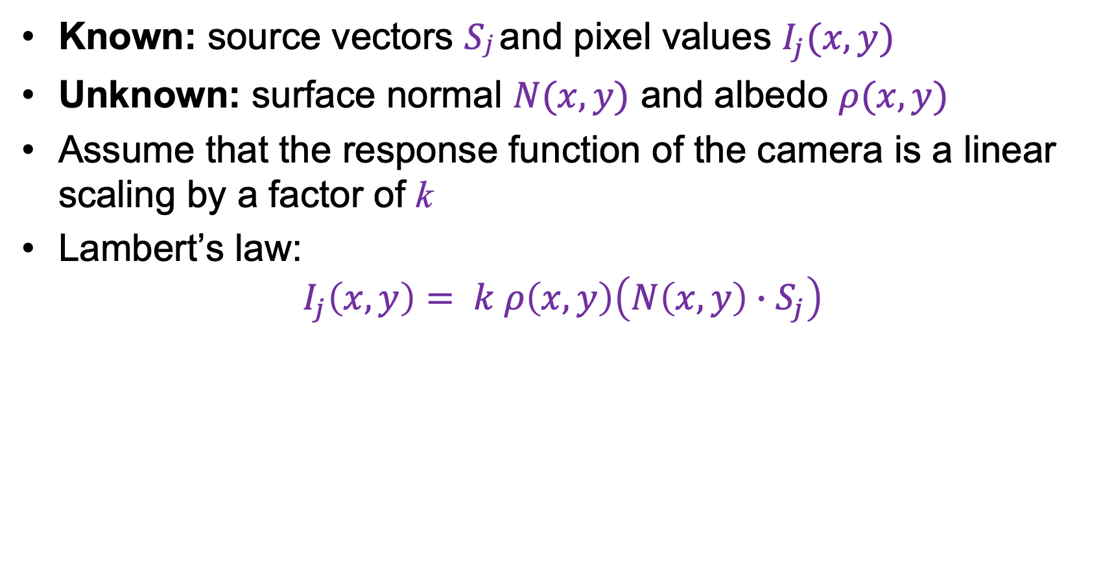


Image model
Known: source vectors $Sj$and pixel values $I_{j}(x,y)$
Unknown: surface normal $N(x,y)$ and albedo $ρ(x,y)$
Assume that the response function of the camera is a linear scaling by a factor of k
Lambert’s law:
$$I_{j}\left(x,y\right)= k ρ\left(x,y\right)\left(N\left(x,y\right)∙S_{j}\right)$$
$$=\left(ρ\left(x,y\right)N(x,y)\right)∙\left(k S_{j}\right)$$
$$=g(x,y)∙V_{j}$$
F&P 2nd ed., sec. 2.2.4

Slide 38
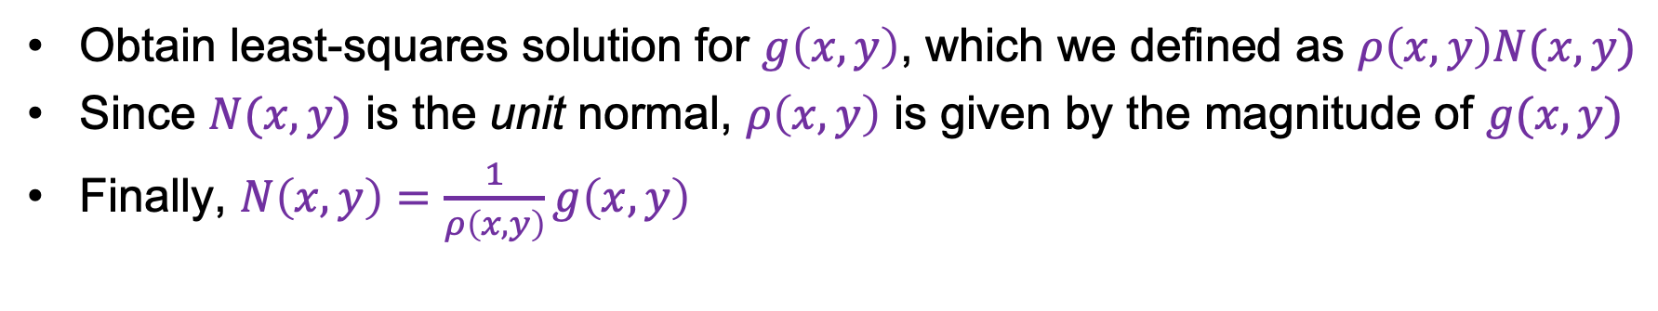
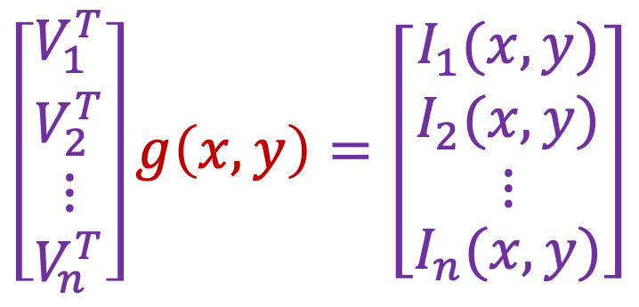



Least squares problem
For each pixel, set up a linear system:
$$\left[\begin{matrix}V_{1}^{T} \\ \begin{aligned}V_{2}^{T} \\ ⋮\end{aligned} \\ V_{n}^{T}\end{matrix}\right]g\left(x,y\right)=\left[\begin{matrix}I_{1}(x,y) \\ \begin{aligned}I_{2}(x,y) \\ ⋮\end{aligned} \\ I_{n}(x,y)\end{matrix}\right]$$
$$n × 3$$
$$3 × 1$$
$$n × 1$$
known
unknown
known
Obtain least-squares solution for $g\left(x,y\right)$, which we defined as $ρ\left(x,y\right)N(x,y)$
Since $N(x,y)$ is the unit normal, $ρ\left(x,y\right)$ is given by the magnitude of $g(x,y)$
Finally, $N\left(x,y\right)=\frac{1}{ρ\left(x,y\right)}g\left(x,y\right)$
F&P 2nd ed., sec. 2.2.4

Slide 39
Synthetic example
Recovered albedo
Recovered normal field
F&P 2nd ed., sec. 2.2.4

Slide 40
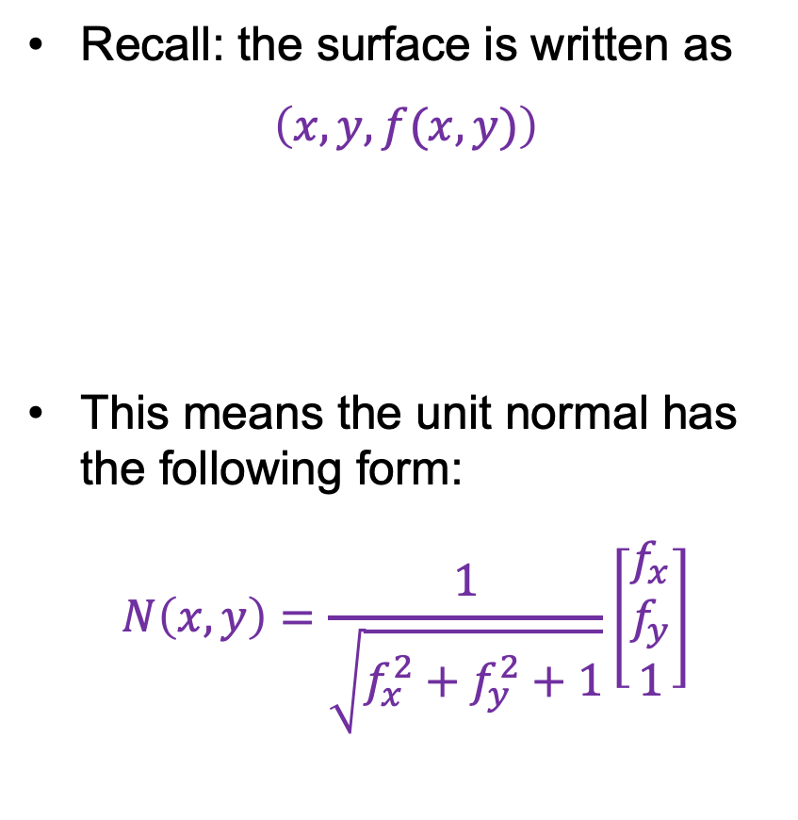
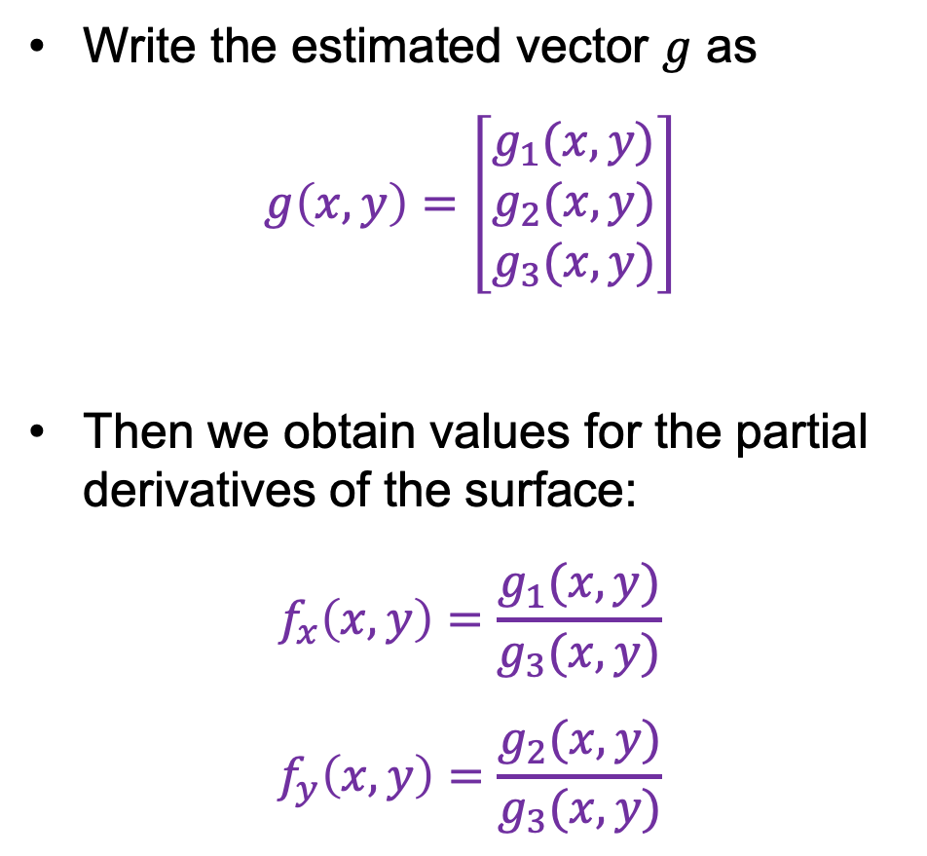
Recovering a surface from normals
Recall: the surface is written as
$$\left(x,y,f(x,y)\right)$$
This means the unit normal has the following form:
$$N\left(x,y\right)=\frac{1}{\sqrt{f_{x}^{2}+f_{y}^{2}+1}}\left[\begin{matrix}f_{x} \\ f_{y} \\ 1\end{matrix}\right]$$
Write the estimated vector $g$ as
$$g\left(x,y\right)=\left[\begin{matrix}g_{1}(x,y) \\ g_{2}(x,y) \\ g_{3}(x,y)\end{matrix}\right]$$
Then we obtain values for the partial derivatives of the surface:
$$f_{x}\left(x,y\right)=\frac{g_{1}(x,y)}{g_{3}(x,y)}$$
$$f_{y}\left(x,y\right)=\frac{g_{2}(x,y)}{g_{3}(x,y)}$$
F&P 2nd ed., sec. 2.2.4

Slide 41
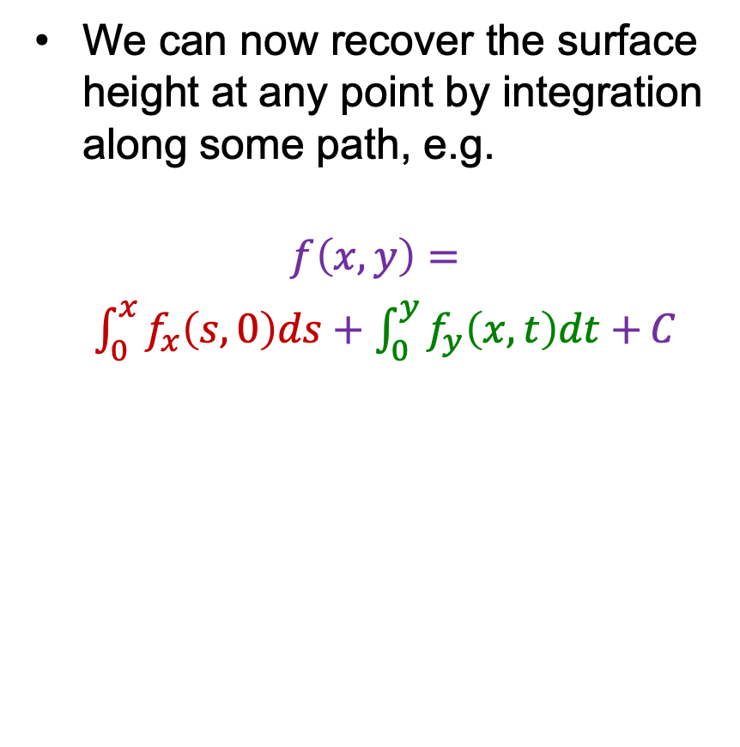



Recovering a surface from normals
We can now recover the surface height at any point by integration along some path, e.g.
$$f\left(x,y\right)=$$
$\int_{0}^{x}{f_{x}\left(s,0\right)ds}+\int_{0}^{y}{f_{y}\left(x,t\right)dt+}C$
$$(0,0)$$
$$(x,0)$$
$$(x,y)$$
For robustness, it is better to take integrals over many different paths and average the results
F&P 2nd ed., sec. 2.2.4

Slide 42
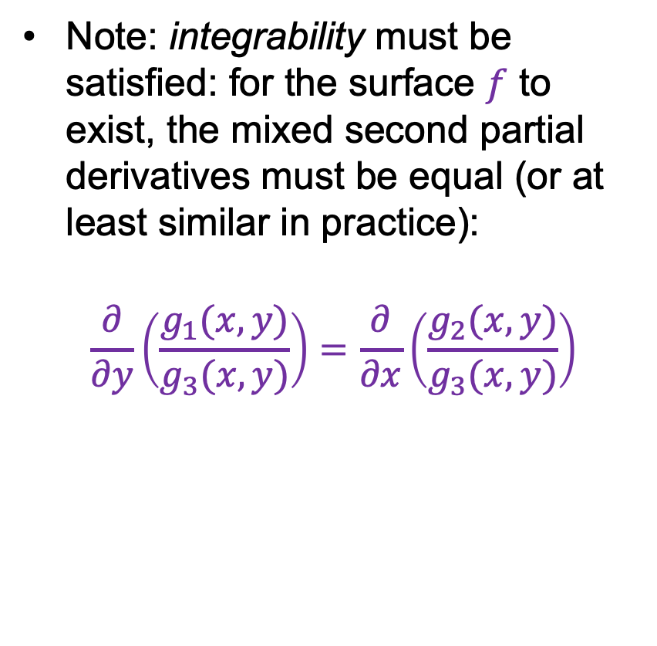
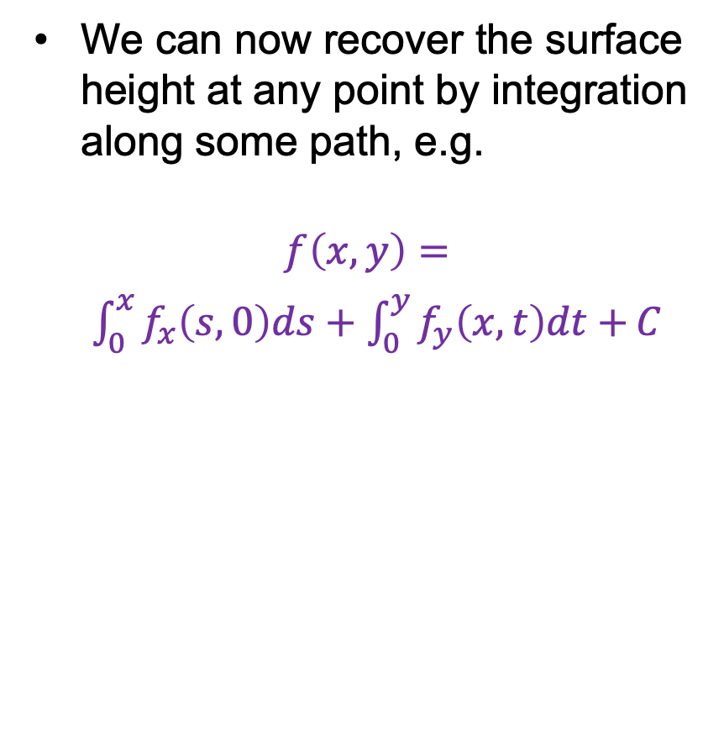
Recovering a surface from normals
We can now recover the surface height at any point by integration along some path, e.g.
$$f\left(x,y\right)=$$
$\int_{0}^{x}{f_{x}\left(s,0\right)ds}+\int_{0}^{y}{f_{y}\left(x,t\right)dt+}C$
Note: integrability must be satisfied: for the surface $f$ to exist, the mixed second partial derivatives must be equal (or at least similar in practice):
$$\frac{∂}{∂y}\left(\frac{g_{1}(x,y)}{g_{3}(x,y)}\right)=\frac{∂}{∂x}\left(\frac{g_{2}(x,y)}{g_{3}(x,y)}\right)$$
For robustness, it is better to take integrals over many different paths and average the results
F&P 2nd ed., sec. 2.2.4

Slide 43
Surface recovered by integration
F&P 2nd ed., sec. 2.2.4

Slide 44
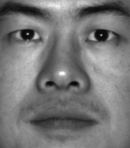
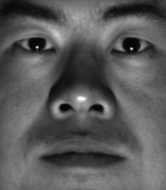
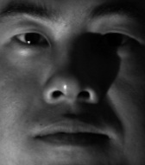
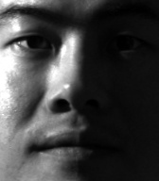
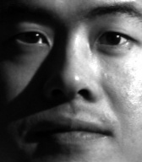

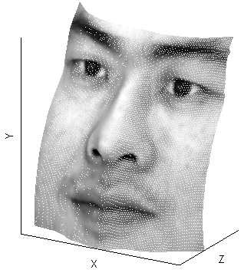
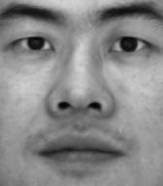






MP4 preview
Input
…
Recovered albedo
Recovered surface model
Recovered normal field
$$x$$
$$y$$
$$z$$

Slide 45
Limitations of basic shape from shading
Orthographic camera model
Simplistic reflectance and lighting model
No shadows
No interreflections
No missing data
Integration is tricky

Slide 46

Shape from shading today
X. Du et al. Generative Models: What do they know? Do they know things? Let's find out! CVPR 2024 workshops

Slide 47

Shape from shading today
Stable Diffusion
X. Du et al. Generative Models: What do they know? Do they know things? Let's find out! CVPR 2024 workshops

Slide 48
Outline
Small taste of radiometry
In-camera transformation of light
Reflectance properties of surfaces
Diffuse and specular reflection
Shape from shading
Estimating direction of light sources

Slide 49





Finding the direction of the light source
$$I(x,y) = N(x,y) ·S(x,y)$$
$$N$$
$$S$$
Full 3D case:
$$\left[\begin{matrix}N_{x}(x_{1},y_{1}) & N_{y}(x_{1},y_{1}) & N_{z}(x_{1},y_{1}) \\ \begin{aligned}N_{x}(x_{2},y_{2}) \\ ⋮\end{aligned} & \begin{aligned}N_{y}(x_{2},y_{2}) \\ ⋮\end{aligned} & \begin{aligned}N_{z}(x_{2},y_{2}) \\ ⋮\end{aligned} \\ N_{x}(x_{n},y_{n}) & N_{y}(x_{n},y_{n}) & N_{z}(x_{n},y_{n})\end{matrix}\right]\left[\begin{matrix}S_{x} \\ S_{y} \\ S_{z}\end{matrix}\right]=\left[\begin{matrix}I(x_{1},y_{1}) \\ \begin{aligned}I(x_{2},y_{2}) \\ ⋮\end{aligned} \\ I(x_{n},y_{n})\end{matrix}\right]$$
P. Nillius and J.-O. Eklundh. Automatic estimation of the projected light source direction. CVPR 2001
Notes:
We assume the object has uniform albedo, which gets “rolled into” the magnitude of the light source term

Slide 50
Finding the direction of the light source
Consider points on the occluding contour:
N_{z} = 0
Image
N_{z} positive
N_{z} negative
Projection direction (z)
P. Nillius and J.-O. Eklundh. Automatic estimation of the projected light source direction. CVPR 2001
Notes:
We assume the object has uniform albedo, which gets “rolled into” the magnitude of the light source term

Slide 51




Finding the direction of the light source
$$I(x,y) = N(x,y) ·S(x,y)$$
Full 3D case:
$$\left[\begin{matrix}N_{x}(x_{1},y_{1}) & N_{y}(x_{1},y_{1}) & N_{z}(x_{1},y_{1}) \\ \begin{aligned}N_{x}(x_{2},y_{2}) \\ ⋮\end{aligned} & \begin{aligned}N_{y}(x_{2},y_{2}) \\ ⋮\end{aligned} & \begin{aligned}N_{z}(x_{2},y_{2}) \\ ⋮\end{aligned} \\ N_{x}(x_{n},y_{n}) & N_{y}(x_{n},y_{n}) & N_{z}(x_{n},y_{n})\end{matrix}\right]\left[\begin{matrix}S_{x} \\ S_{y} \\ S_{z}\end{matrix}\right]=\left[\begin{matrix}I(x_{1},y_{1}) \\ \begin{aligned}I(x_{2},y_{2}) \\ ⋮\end{aligned} \\ I(x_{n},y_{n})\end{matrix}\right]$$
$$N$$
$$S$$
For points on the occluding contour ($N_{z}=0$):
$$\left[\begin{matrix}N_{x}(x_{1},y_{1}) & N_{y}(x_{1},y_{1}) \\ \begin{aligned}N_{x}(x_{2},y_{2}) \\ ⋮\end{aligned} & \begin{aligned}N_{y}(x_{2},y_{2}) \\ ⋮\end{aligned} \\ N_{x}(x_{n},y_{n}) & N_{y}(x_{n},y_{n})\end{matrix}\right]\left[\begin{matrix}S_{x} \\ S_{y}\end{matrix}\right]=\left[\begin{matrix}I(x_{1},y_{1}) \\ \begin{aligned}I(x_{2},y_{2}) \\ ⋮\end{aligned} \\ I(x_{n},y_{n})\end{matrix}\right]$$
P. Nillius and J.-O. Eklundh. Automatic estimation of the projected light source direction. CVPR 2001
Notes:
We assume the object has uniform albedo, which gets “rolled into” the magnitude of the light source term

Slide 52

Finding the direction of the light source
P. Nillius and J.-O. Eklundh. Automatic estimation of the projected light source direction. CVPR 2001

Slide 53


Application: Detecting composite photos
Real photo
Fake photo
M. K. Johnson and H. Farid. Exposing Digital Forgeries by Detecting Inconsistencies in Lighting. ACM Multimedia and Security Workshop, 2005

Slide 54

DeepFake detection today
A. Sarkar et al. Shadows Don’t Lie and Lines Can’t Bend! Generative Models don’t know Projective Geometry ... for now. CVPR 2024

